Slide 1
210 Pax Aircraft Proposal
November 29th, 2023
Team 13
Will Cooperider, Worren Hu, Noor Ladha, Vishnu Sankar

Slide 2
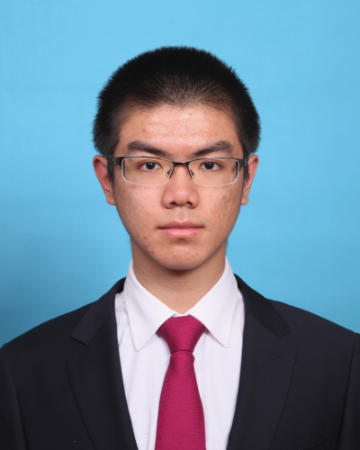
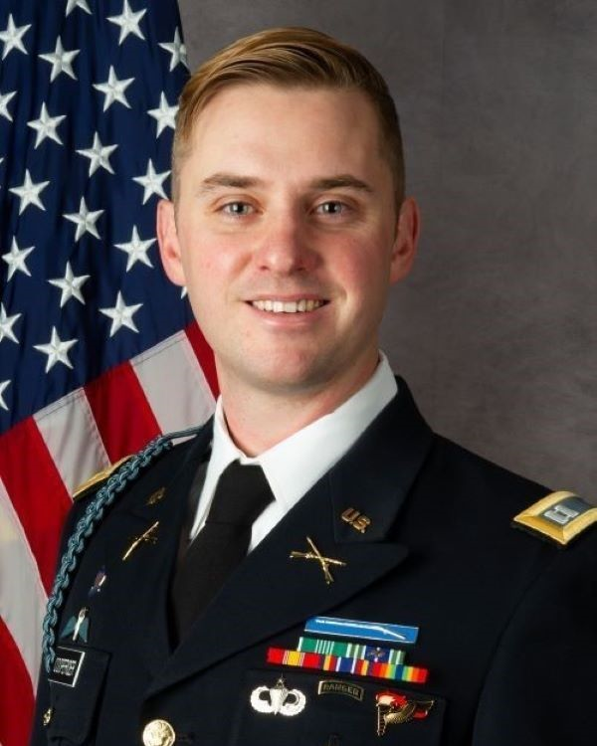

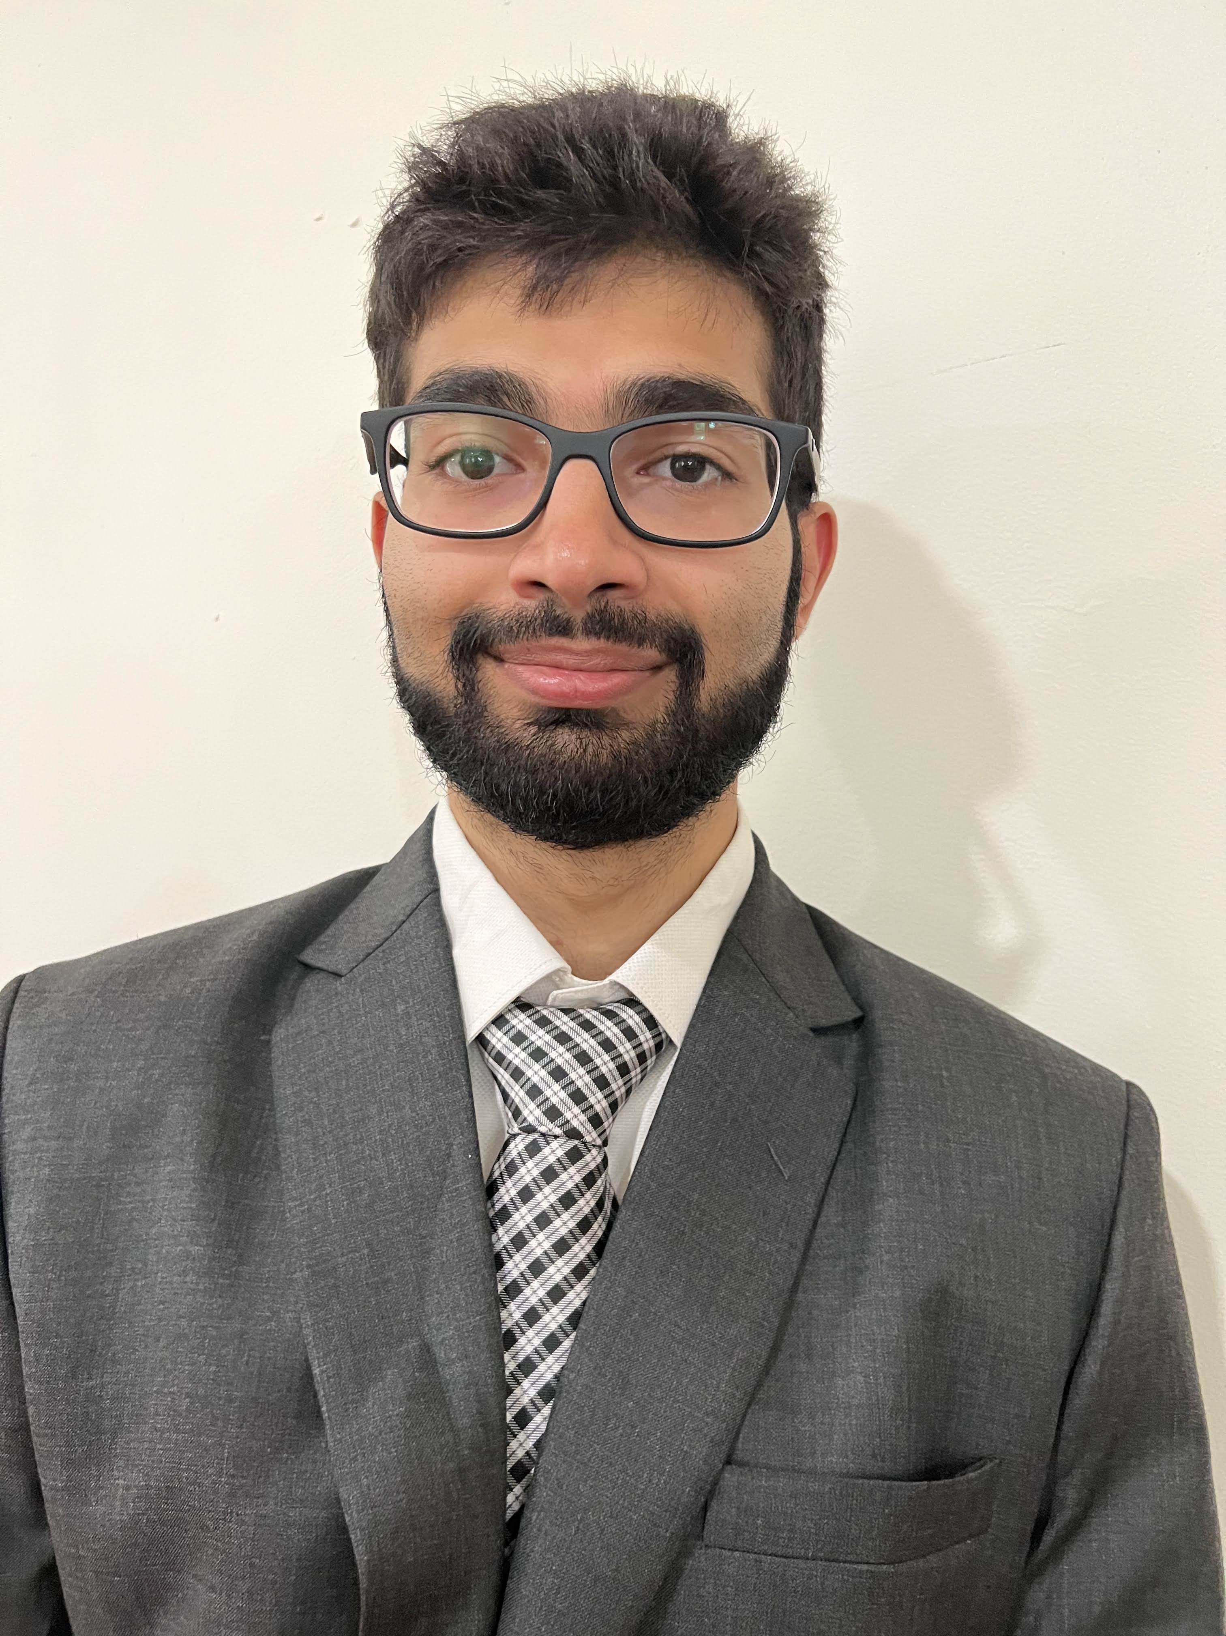

Proposal Team
Noor Ladha
Worren Hu
Will Cooperider
Vishnu Sankar

Slide 3





Agenda
Problem Definition
Concept Space Exploration
Please refer to the Quick Reference Guide in your booklet throughout for convenience
Design Space Exploration
Technology Exploration
Concept Proposal

Slide 4
The Complexity of the Problem Space
Problem Definition
Concept Space Exploration
Design Space Exploration
People Want to Fly
Need more planes
Technology Exploration
Concept Proposal
Notes:
People want to fly, so we need new planes

Slide 5
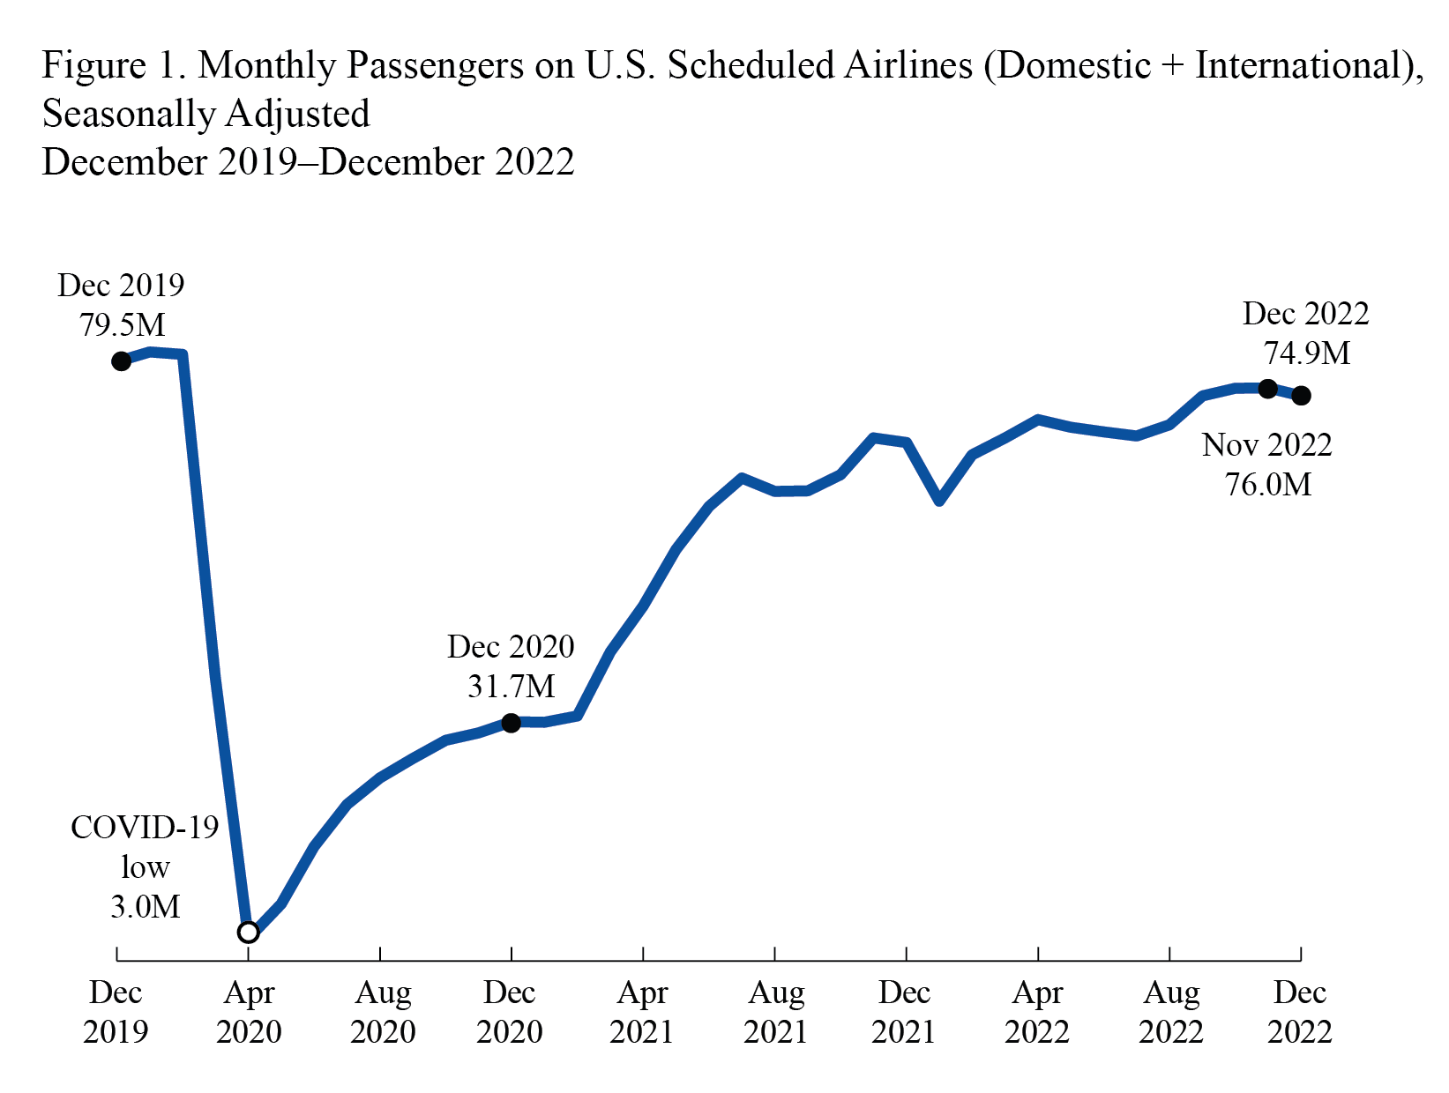
Market Demand
Commercial Aviation is a decisive and vital component of global commercial infrastructure
Problem Definition
Concept Space Exploration
In 2017, 37 million commercial flights carried 4.1 billion passengers, 56 million tons of cargo [1]
Design Space Exploration
Technology Exploration
Concept Proposal
The air transport industry is projected to balloon to $1.6 trillion per annum of the GDP as early as 2036 [1]
Increased Demand Requires More Planes
[1] International Civil Aviation Organization, "Future of Aviation", 2023.
Image Credit: US DOT Bureau of Transportation Statistics
Notes:
https://www.bts.gov/newsroom/full-year-2022-us-airline-traffic-data

Slide 6

The Complexity of the Problem Space
Problem Definition
Concept Space Exploration
Design Space Exploration
People Want to Fly
Need more planes
Technology Exploration
Concept Proposal
Increased Demand for Planes means Increased Demand for Environmentally Friendly Planes
Notes:
https://www.icao.int/environmental-protection/Pages/LTAG.aspx

Slide 7
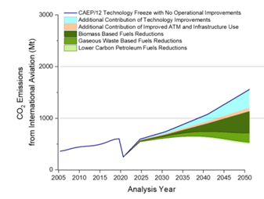
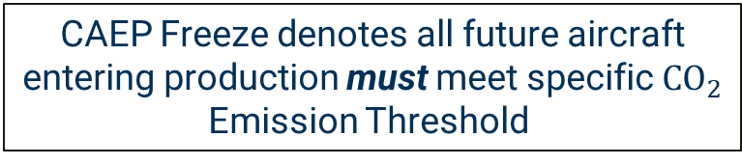
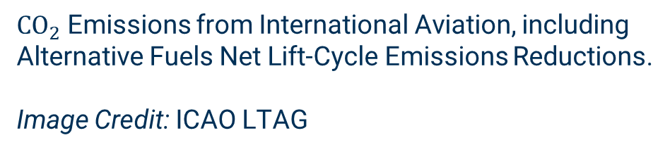
Emission Reduction
Industry is Demanding aircraft to meet stringent carbon emission constraints
Problem Definition
Concept Space Exploration
CAEP Freeze denotes all future aircraft entering production must meet specific ${CO}_{2}$ Emission Threshold
Design Space Exploration
Technology Exploration
${CO}_{2}$ Emissions from International Aviation, including Alternative Fuels Net Lift-Cycle Emissions Reductions.
Image Credit: ICAO LTAG
Concept Proposal
Need to explore the full spectrum of design injects for future aircraft production to meet the emission requirements
Increased Demand for Planes means Increased Demand for Environmentally Friendly Planes
Notes:
https://www.icao.int/environmental-protection/Pages/LTAG.aspx

Slide 8

The Complexity of the Problem Space
Problem Definition
Concept Space Exploration
Design Space Exploration
People Want to Fly
Need more planes
Technology Exploration
Concept Proposal
Increased Demand for Planes means Increased Demand for Environmentally Friendly Planes
Building New Planes to meet both constraints and demand is expensive
Notes:
To build a lot of new planes, that is expensive

Slide 9
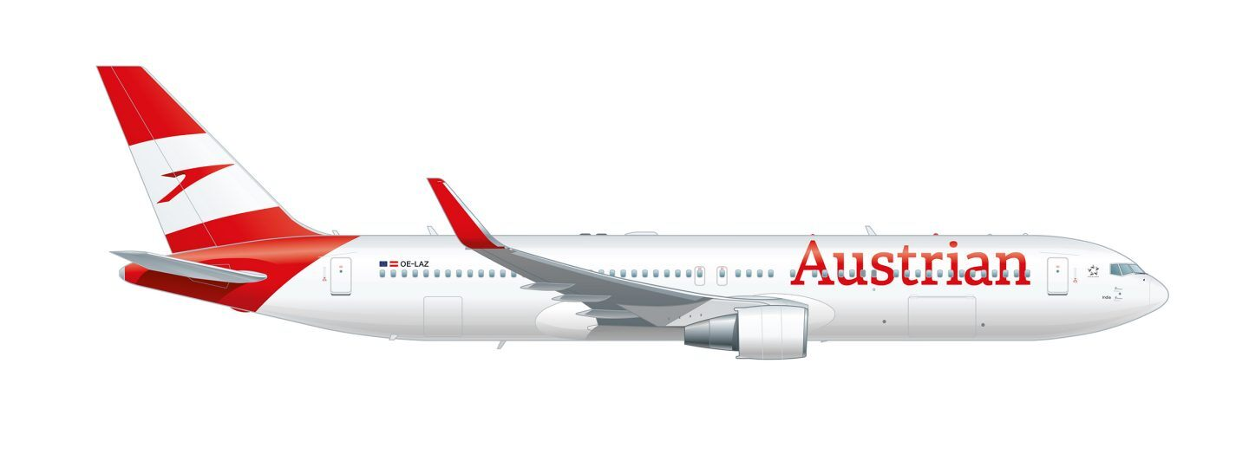
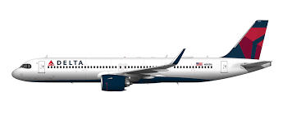
Current Capabilities of Narrow Body Aircraft
Narrow body (NBA), Large Single Aisle (LSA) and Small Twin Aisle (STA) aircraft have unmatched versatility
Problem Definition
Concept Space Exploration
Australian Airlines Boeing 767-300ER
Design Space Exploration
NBA's can move 150 – 300 PAX and up to 30,000 lbs of Cargo [3]
Building New Planes to meet both constraints and demand is expensive
Technology Exploration
Concept Proposal
29,530 new NBAs must enter production within the next 20 years to meet the present market demand [4]
Delta Airbus 321 Neo
[2]Cargo Flash. "Types of Aircraft Used in Air Cargo Business: 2023 Edition" 2023. Available: Online
[3] Chandrakanth, R. "Engines that Power Narrowbody Planes". SPS Aviation. 07 JUL 2017. Available: Online
Notes:
Here’s what we’re currently working with

Slide 10
The Complexity of the Problem Space
Problem Definition
Concept Space Exploration
Design Space Exploration
People Want to Fly
Need more planes
Technology Exploration
Concept Proposal
Increased Demand for Planes means Increased Demand for Environmentally Friendly Planes
Building New Planes to meet both constraints and demand is expensive

Slide 11
The Complexity of the Problem Space
Problem Definition
Concept Space Exploration
Industry Need: An aircraft design solution that meets increased market demand and never-before-seen stringent standards of performance and emissions
Design Space Exploration
People Want to Fly
Need more planes
Technology Exploration
Concept Proposal
Increased Demand for Planes means Increased Demand for Environmentally Friendly Planes
Building New Planes to meet both constraints and demand is expensive
Notes:
So understand the intersection of these three gives us the industry need for a new aircraft

Slide 12
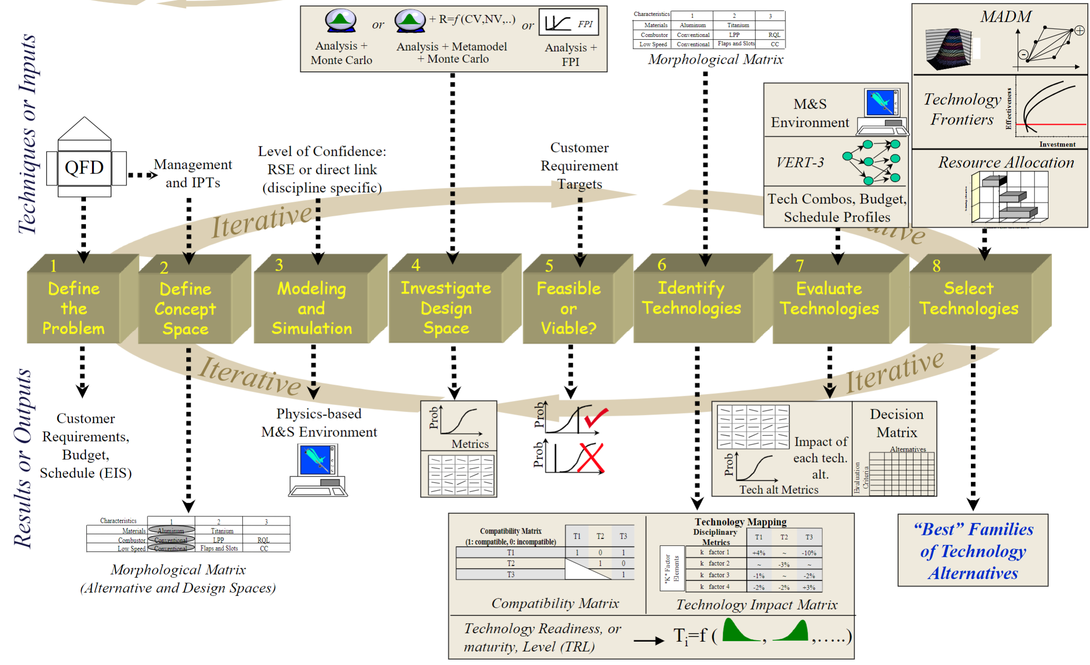
Methodology for Solving the Problem
Problem Definition
Concept Space Exploration
Design Space Exploration
Technology Exploration
Concept Proposal
[4]
[4] Mavris, Dimitri. "Technology Identification, Evaluation, and Selection (TIES) Method," Georgia Institute of Technology, Lecture, 2023.
Notes:
We’re going to solve the problem by using the TIES method in order to meet this industry need.

Slide 13
Holistic Requirements Analysis
Quality Function Deployment ^{[1]}
Describes the relationship between the voice of the customer and engineering characteristics
Includes competitors used for benchmarking
Boeing 767-300ER
Airbus A330-200
Airbus A321neo
Performs technological competitive assessment between our product and competitors
QFD provides basis for generating (SMART) Specific, Measurable, Achievable, Relevant, and Traceable requirements
Requirements Analysis ^{[1]}
Transforms identified top-level needs and objectives into system functional and performance requirements that specifically define
What the system must do
How well it must perform
What must be accomplished to ensure operational capabilities
How interfacing requirements must be met
Customers budget and schedule is also considered
Problem Definition
Concept Space Exploration
Design Space Exploration
Technology Exploration
Concept Proposal
Requirements and constraints determine the problem’s conceptual space
[4] Mavris, Dimitri. “Aerospace Systems Engineering Requirements" Georgia Institute of Technology, Lecture, 2023
Notes:
So we’ve defined the concept space, how did we get this space? Through a requirements analysis

Slide 14
Design Goals and Target Metrics
Three main target types
Percentage Decrease
Approach Speed
TOFL
OEW
NOx
Acquisition Price with Spares
DOC+I
Constrained
Wingspan
NOx Certification Limit
Minimized
RPM
RDT&E
Parameter | Target
Approach Speed (fieldVAPP [ft/s]) | Decreased by 15%
Balanced Take-off Field Length (FAR_TOFL [ft]) | Decreased by 15%
Operating Empty Weight (OEW [lb]) | Decreased by 25%
Wing-Span [ft] | Constrained
Nitrogen Oxide Emissions (dPfooNOx [g/kN]) | Decreased by 20%
Nitrogen Oxide Certification Limit (CAEP8_Limit) | Constrained
Acquisition Price with Spares (Avg_UnitCostSpares , [M$]) | Decreased by 15%
Research, Development, Testing and Evaluation cost (RDTE [M$]) | Minimized
Direct Operating Cost plus Interest (DOC_I [¢/ASM]) | Decreased by 20%
Required Yield per revenue passenger mile (RPM, [$]) | Minimized
Problem Definition
Concept Space Exploration
Design Space Exploration
Technology Exploration
Concept Proposal
Notes:
These are the requiments that we present , since this are just numbers on a slide what would this actually look like for an aircraft flying a specific mission this will help us begin the sizing proccess.

Slide 15
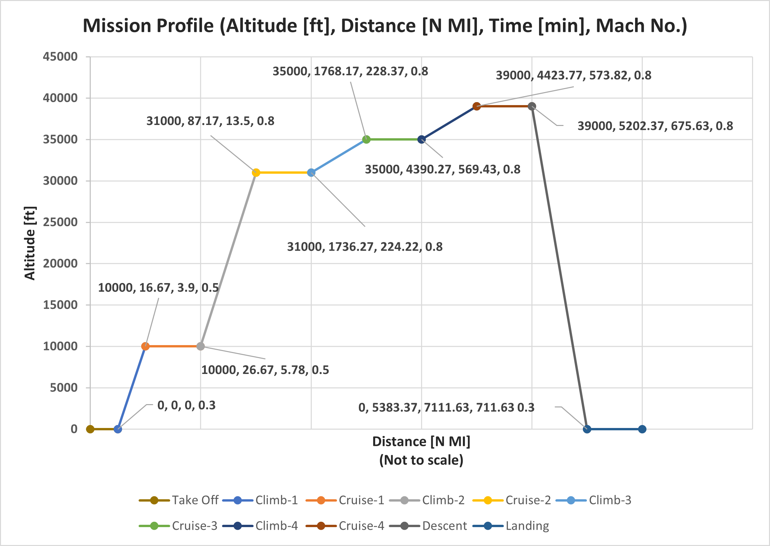
Mission Profile
This mission profile is designed for a commercial transport aircraft
Describes key performance constraints like range, and cruising altitude to meet specific travel demands
Outlines operational envelope including speed profiles
Problem Definition
Concept Space Exploration
Design Space Exploration
Technology Exploration
Concept Proposal
Notes:
Transition: Take the mission profile and keeping the requirements in mind we generate a matrix which contains alternative

Slide 16
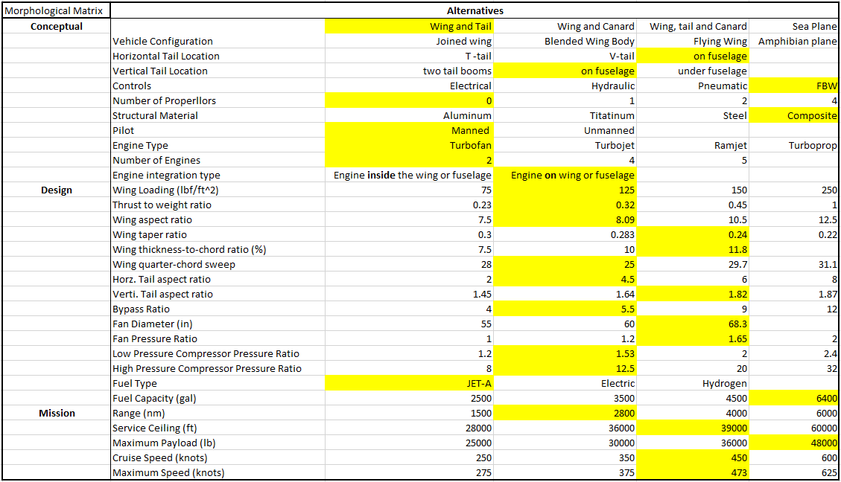
Morphological Matrix
Morphological Matrix designed to develop possible alternatives of vehicle configurations based on desired functions
Baseline vehicle configuration highlighted in yellow
With 8 different vehicle configurations, 2 to 3 horizontal and vertical tail positions, 4 different control methods, 4 main structural materials, 4 engine configurations, and 3 number of engine configurations that gives us a total of 9216 conceptual alternatives alone (not including design or mission alternatives)
This assumes every variable is independent to build a complete and unrefined design space
Problem Definition
Concept Space Exploration
Design Space Exploration
Technology Exploration
Concept Proposal
Notes:
What are the conceptual alternatives when designing this aircraft. With this base line selected we can choose a mock up to start infusing technologies on

Slide 17
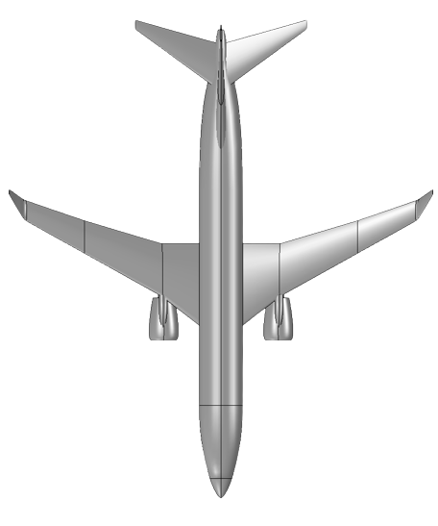
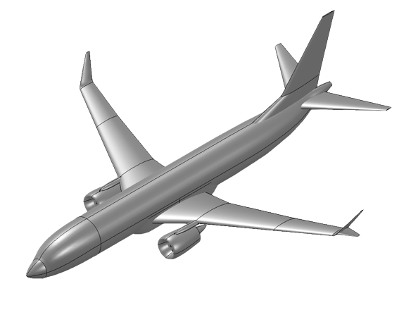
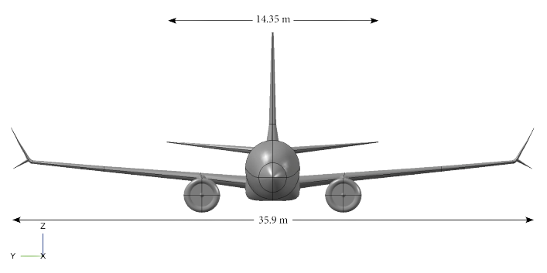
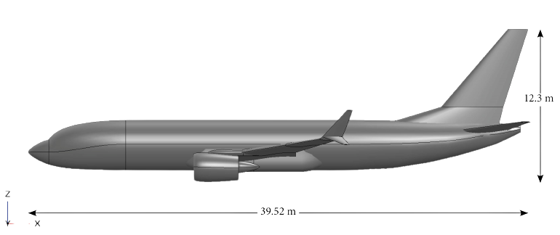
Baseline Identification
With the given requirements the Boeing 767-300ER was chosen as the baseline 210 pax vehicle model
Baseline is going to be optimized for the desired mission
Problem Definition
Characteristic​ | Value​
Thrust to Weight Ratio​ | 0.26527​
Wing Loading​ | 118.6524 (lbf/ft²)​
Span​ | 156.1 ft​
Single Engine Thrust​ | 48,000 lbf​
Concept Space Exploration
Design Space Exploration
Technology Exploration
Weight​ | Value (lb)​
Operating Empty Weight​ | 176,650​
Payload Weight​ | 73,350
Max Fuel Weight​ | 111,890
Gross Weight​ | 361,890​
Concept Proposal
Notes:
https://en.wikipedia.org/wiki/Boeing_767
So we’ve turned to the Boeing 767 -300 ER as our chosen baseline for this profile

Slide 18
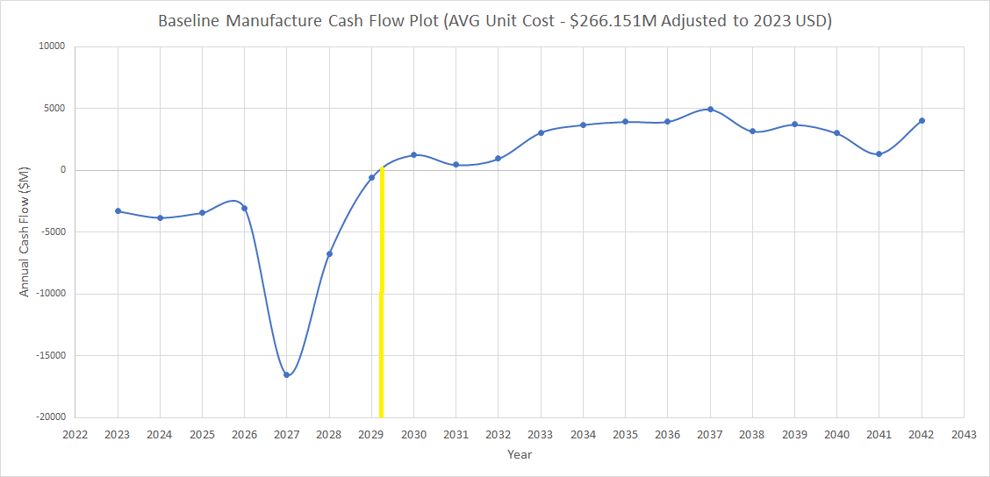
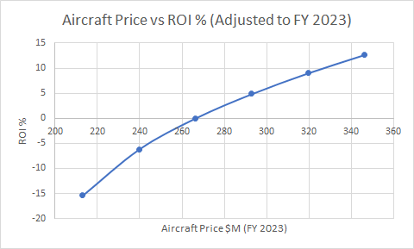
Manufacturer Economics Analysis
Problem Definition
Concept Space Exploration
Design Space Exploration
Technology Exploration
Yellow line represents break even point
Concept Proposal
All calculations for Cashflow and ROI (%) are in 2005 USD for a 20-year production schedule and have been adjusted to a 2023 timeline and FY 2023
Manufacturer will break even in 6+ years with a 0 % ROI
ROI with a baseline cost $266.3011 M (FY2023) is 0 %
Average aircraft manufacturing cost is set as $343.266 M (FY2023) for 800 aircraft for an ROI of 12%
Notes:
I’m going to orient you to the slide as such, on the left the is the capital investment made by you, we’ve adjusted the dollars from 20

Slide 19
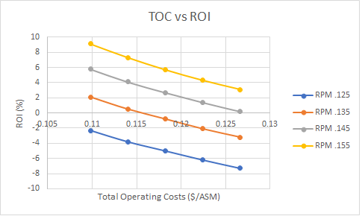
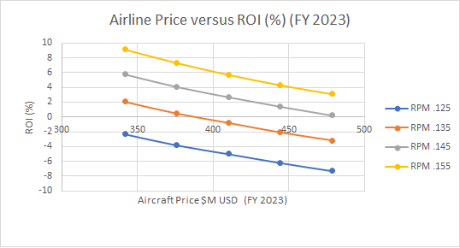
Return on Investment for Airlines
Problem Definition
Concept Space Exploration
Design Space Exploration
Technology Exploration
Dollars per available seat mile, a lower number implies greater efficiency or lower cost as it means the airline is spending less money to fly each seat one mile
Concept Proposal
Airline performs 693 Trips per year with a trip distance of 3200 nmi
At the baseline value of .15773 Average Yield/RPM the airline return on investment is 10% and the final aircraft price is $341.75 M USD (FY 2023)
By reducing the acquisition price, thus the learning curve, the RPM will decrease for the same ROI thus increasing the airlines profit
Notes:
Add conclusion box, that mentions this process is expensive, what are some viable solutions hand off to worren.

Slide 20
Design Space Exploration
Design Variables
Design of Experiments
Surrogate Models
Checking for goodness
Feasible Space
Optimized Baseline
Economic Design Space
Performance Design Space

Slide 21
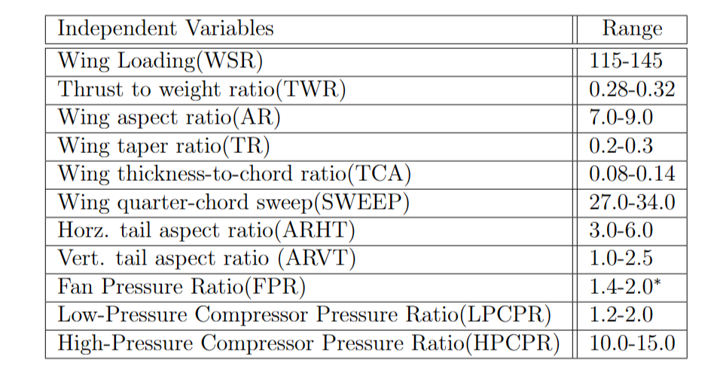
Design Variables
Problem Definition
Concept Space Exploration
Design Space Exploration
Technology Exploration
Concept Proposal
11 variables in total
Each with an appropriate range
Determined according to the baseline values
Mostly are related to geometric or propulsive features

Slide 22
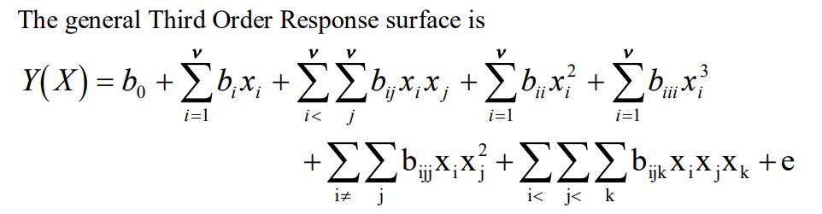
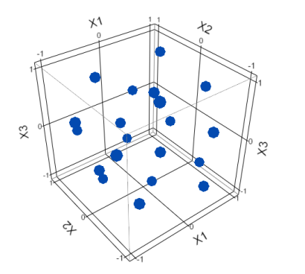
Design of Experiments with 11 Design Variables
The constraint is 5000 cases of experiments
And all 11 design variables are continuous
Full factorial design is impossible
The design variables are fed into Environment Design Space to simulate their impacts on other variables.
The solution is a mixture of designs:
Edge cases: exploring the corner points, edges, and surfaces (3rd order relations)
Interior cases: random space filling points generated by Latin Hypercube
Problem Definition
Concept Space Exploration
Design Space Exploration
Technology Exploration
Concept Proposal
Notes:
A note on Variance-Sum Third Order Slope Rotatable Designs, R. Md. Mastan Shareef, B. Guravaiah, G. V. S. R. Anjaneyulu

Slide 23
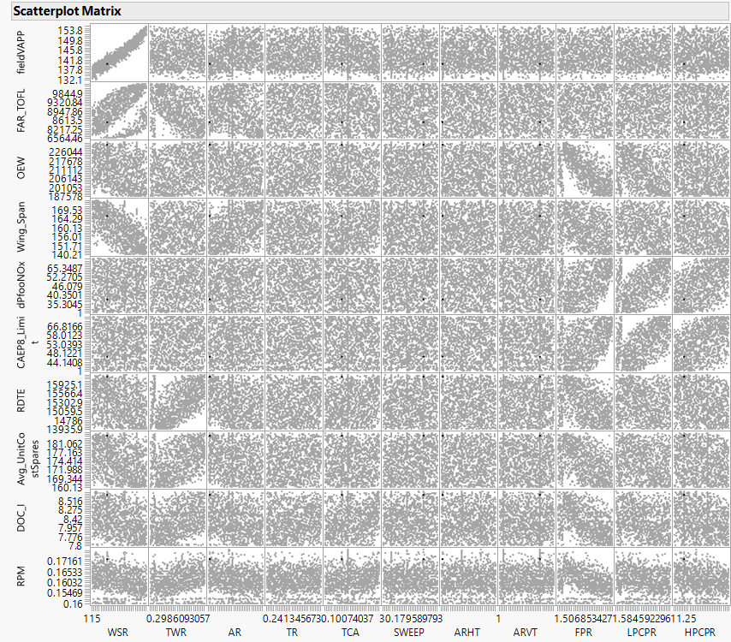
Surrogate Models
Response Surface Methodology(RSM)
Easy to set up
Capable of building most surrogate models
Artificial Neutral Net(ANN)
Handle what remains(Balanced take-off field length, or FAR_TOFL)
Adequacy checked
Problem Definition
Concept Space Exploration
Design Space Exploration
Technology Exploration
Concept Proposal

Slide 24
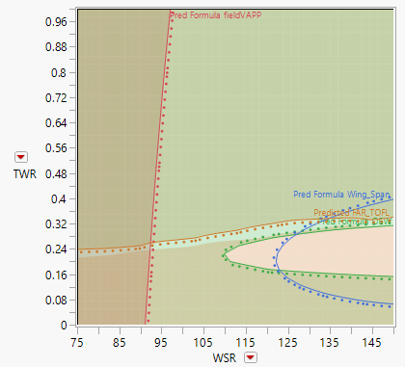
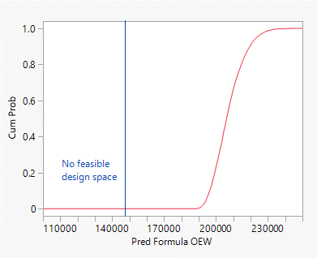
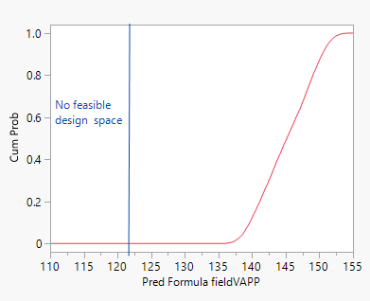
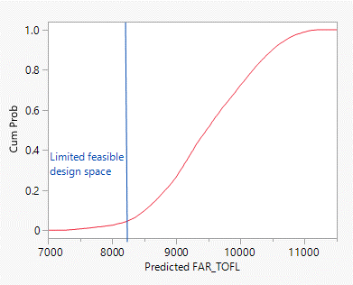
Performance Design Space
No feasible design space for approach speed(field_VAPP) and operating empty weight(OEW)
Contour plot(TWR/WSR) is shown
If NO new technology infused, constraints need to be relaxed
Approach Speed - Reduce by 7.5% instead of 15%
Operating Empty Weight - Reduce by 12.5% instead of 25%
Problem Definition
Concept Space Exploration
Design Space Exploration
Technology Exploration
Concept Proposal
Limited Feasible Space
NO Feasible Space
NO Feasible Space

Slide 25
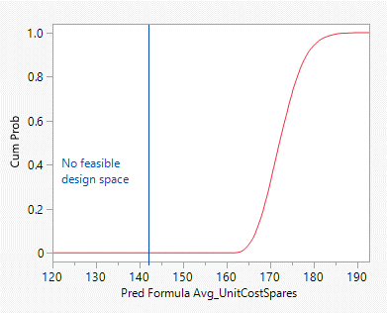
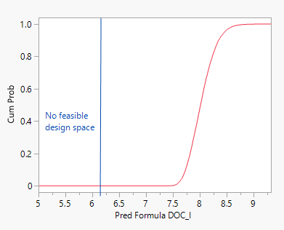
Economics Design Space
A feasible space exists for the economics contour plot
Contour plot(TWR/WSR) is shown
No feasible design space(exact equality values) for:
direct operating costs plus interest(DOC_I)
average unit cost plus spares (Avg_UnitCostSpares)
Problem Definition
NO Feasible Space
Concept Space Exploration
Design Space Exploration
Technology Exploration
Concept Proposal
NO Feasible Space

Slide 26
Optimized Baseline
Comparing with original baseline values
Optimized Baseline values
7 of 11 design variables are set to the corresponding minimum
2 of 3 remaining variables get reduced
Only 1 variable(LPCPR) get increased
Design Variable | Baseline | Optimized
WSR | 129.08 lb/ft² | 115 lb/ft² (MIN)
TWR | 0.2966 | 0.28(MIN)
AR | 8.091 | 7(MIN)
TR | 0.2458 | 0.2(MIN)
TCA | 0.1095 | 0.09329
SWEEP | 30.73 deg | 27 deg (MIN)
ARHT | 4.5 | 3(MIN)
ARVT | 1.82 | 1(MIN)
FPR | 1.645 | 1.576
LPCPR | 1.527 | 1.681
HPCPR | 12.59 | 10.95
Problem Definition
Concept Space Exploration
Design Space Exploration
Technology Exploration
Concept Proposal

Slide 27
Compare the Baselines
Response | Baseline | Optimized baseline | Percentage Change
fieldVAPP [ft/s] | 145 | 136.6 | -5.8
FAR_TOFL [ft] | 9690.44 | 9442.25 | -2.6
OEW [lb] | 198440 | 202356 | +2.0
Wing_Span [ft] | 154.77 | 153.93 | -0.5
dPfooNOx | 50.338 | 42.1177 | -16.3
CAEP8_Limit | 55.7654 | 40.7954 | -26.8
RDTE [M$] | 14763.6 | 14635.8 | -0.9
Avg_UnitCostSpares [M$] | 168.54 | 168.48 | 0.0
DOC_I [¢/APM] | 7.83 | 7.87 | +0.6
RPM [$] | 0.15773 | 0.15875 | +0.6
Problem Definition
Concept Space Exploration
Design Space Exploration
Technology Exploration
Concept Proposal

Slide 28
Feasible Space
Based on there being no available feasible space we have the following options
Change requirements
Redefine the concept space
Widen design variable ranges
Infuse technologies
Since the first three options are not feasible for projects the last option, infusing technologies will be selected
Problem Definition
Concept Space Exploration
Design Space Exploration
Technology Exploration
Concept Proposal

Slide 29
Technology Infusion Analytical Approach
Optimized Baseline
Present Output Variables
Technology Impact Matrix
Name | Variable | T1 | ... | T80
Wing Weight | FRWI | + / - # | ... | + / - #
... | HPT_eff | … | … | …
Pressure Ratio | HPCPR | + / - # | + / - # | + / - #
Performance due to Technology Infusion
Isolate Technological Impact
Observe Technology Combination Impact
K-factor
DOE
M&SE
Combinations of Tech
Technology Compatibility Matrix
 | T1 | ... | T80
T1 | ON (1) | … | …
T80 | ... | ... | ON (1)

Slide 30
Technology Effects
Variable | Description
sAccess_Wt | Engine accessories weight fraction of bare engine weight
ATD_Bleed | Bleed Flow injected in the duct
Core_Nozz_s_Wt | Core nozzle weight scalar
d_Burn_dP | Burner Pressure Drop Intercept
FCDO | Lift Independent Drag Factor
FCDSUB | Factor to increase or decrease all subsonic drag coefficients
FRFU | Fuselage Weight Factor
FRHT | Horizontal Tail Weight
FRVT | Vertical Tail Weight
FRWI | Total Wing Weight Factor
FRWI1 | First term in wing weight equation
FRWI2 | Second term in wing weight equation
HPC_AFC_LossRatio | Ratio of baseline coefficient over loss coefficients with active flow control
HPC_AFC_nStages | Number of high-pressure compressor (HPC) stages to apply AFC Efficiency gain to
HPC_Deff | HPC Efficiency delta at aero design point (ADP)
HPC_Dutip | HPC tip speed delta at ADP
HPC_FlowControl | Bleed Flow required per stage
HPC_FSPRmax | Maximum HPC 1st stage pressure ratio
HPCPR | Pressure Ratio for High Pressure Compressor
HPT_delta_desBladeTemp | High Pressure Turbine (HPT) Blade temperature increase
HPT_delta_desVaneTemp1 | HPT Vane 1 temperature increase
HPT_delta_desVaneTemp2 | HPT Vane 2 temperature increase
HPT_eff | HPT Adiabatic efficiency at ADP
HPT_Load | High Pressure Turbine Loading
HPT_Stator_rho | High Pressure Turbine stator material density
HPX | Engine Horse Power Extraction (Constant)
LPT_Deff | Low Pressure turbine efficiency adder
LPT_delta_desBladeTemp | Low pressure turbine blade temperature increase
LPT_delta_desVaneTemp | LPT Bvane temperature increase
LPT_Load | Low pressure turbine loading
LPT_Stator_rho | Low presure turbine stator material density
Each of these Variables Corresponds to Aircraft Performance
Problem Definition
Concept Space Exploration
Design Space Exploration
Technology Exploration
Concept Proposal

Slide 31
Technology Effects
Variable | Description
sAccess_Wt | Engine accessories weight fraction of bare engine weight
ATD_Bleed | Bleed Flow injected in the duct
Core_Nozz_s_Wt | Core nozzle weight scalar
d_Burn_dP | Burner Pressure Drop Intercept
FCDO | Lift Independent Drag Factor
FCDSUB | Factor to increase or decrease all subsonic drag coefficients
FRFU | Fuselage Weight Factor
FRHT | Horizontal Tail Weight
FRVT | Vertiacal Tail Weight
FRWI | Total Wing Weight Factor
FRWI1 | First term in wing weight equation
FRWI2 | Second term in wing weight equation
HPC_AFC_LossRatio | Ratio of baseline coefficient over loss coefficients with active flow control
HPC_AFC_nStages | Number of high-pressure compressor (HPC) stages to apply AFC Efficiency gain to
HPC_Deff | HPC Efficiency delta at aero design point (ADP)
HPC_Dutip | HPC tip speed delta at ADP
HPC_FlowControl | Bleed Flow required per stage
HPC_FSPRmax | Maximum HPC 1st stage pressure ratio
HPCPR | Pressure Ratio for High Pressure Compressor
HPT_delta_desBladeTemp | High Pressure Turbine (HPT) Blade temperature increase
HPT_delta_desVaneTemp1 | HPT Vane 1 temperature increase
HPT_delta_desVaneTemp2 | HPT Vane 2 temperature increase
HPT_eff | HPT Adiabatic efficiency at ADP
HPT_Load | High Pressure Turbine Loading
HPT_Stator_rho | High Pressure Turbine stator material density
HPX | Engine Horse Power Extraction (Constant)
LPT_Deff | Low Pressure turbine efficiency adder
LPT_delta_desBladeTemp | Low pressure turbine blade temperature increase
LPT_delta_desVaneTemp | LPT Bvane temperature increase
LPT_Load | Low pressure turbine loading
LPT_Stator_rho | Low presure turbine stator material density
Each of these Variables Corresponds to Aircraft Performance
Problem Definition
Determined how infusing a new technology impacts the range (TIM)
Concept Space Exploration
Design Space Exploration
Technology Exploration
Concept Proposal

Slide 32
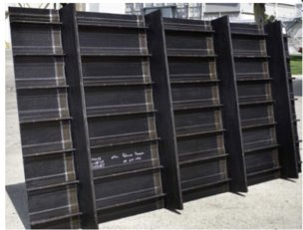
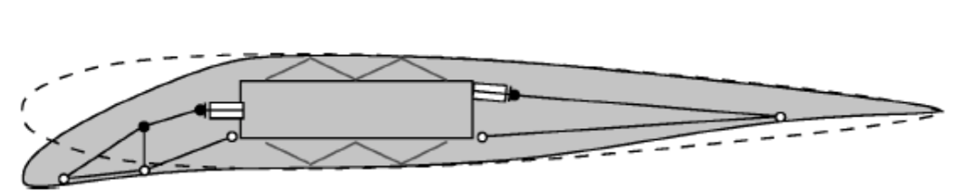
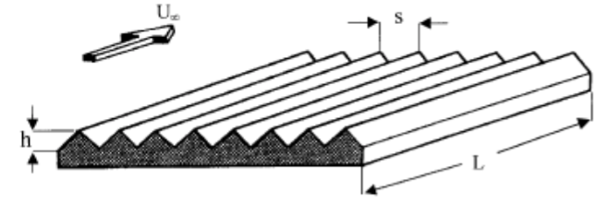
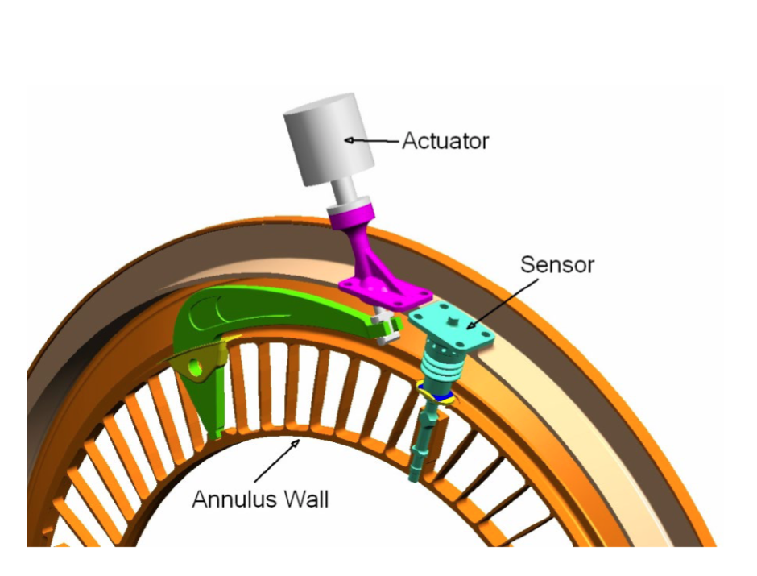
Technology Exploration
LTAG Technology | Technology Name | Effects on Performance | TRL
T3 | Damage Arresting Stitched Composites | Resin-infused dry fabric structures reduce airframe weight | 9
T8 | Adaptive Wing / Variable Camber | Reduces the induced drag on an aircraft by in-flight altering the wing geometry | 6
T12 | Riblets | Ribbing fences that create a span wise viscous force to act on the boundary layer and reduce friction drag | 8
T20a | Active Compressor Clearance Control | Establishing clearance between blade tips and casing at takeoff allows more flow to bypass and increase engine efficiency | 8
T20b | Active Compressor Flow Control | Aspiration induced removal of low energy flow to slow engine blade speed and increase efficiency | 6
Problem Definition
Concept Space Exploration
Design Space Exploration
Technology Exploration
Concept Proposal

Slide 33
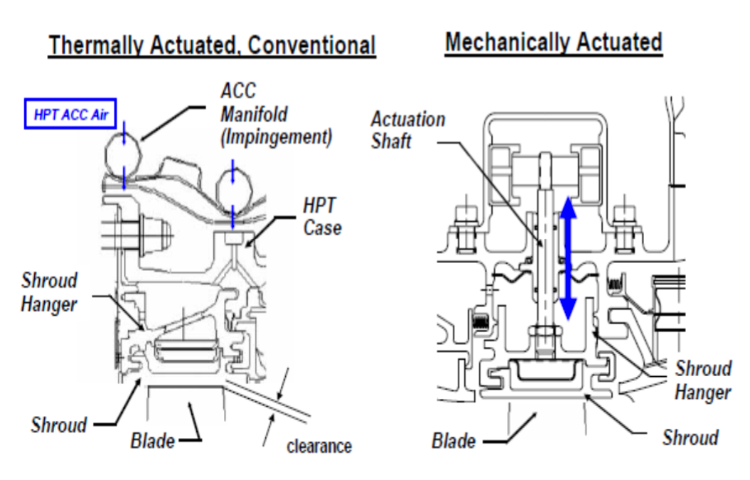
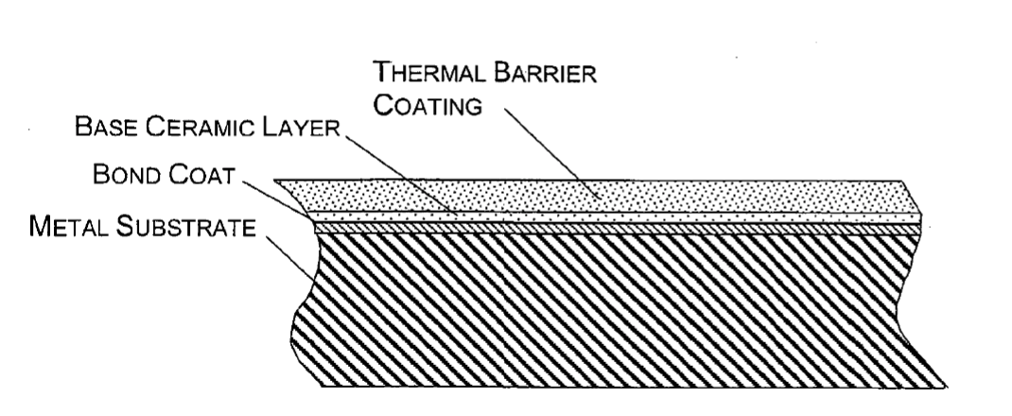
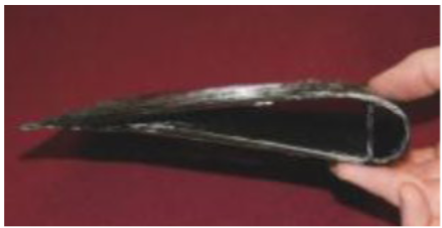
Technology Exploration
LTAG Technology | Technology Name | Effects on Performance | TRL
T23 | Active Turbine Clearance Control: Mechanically Actuated | By reducing the spacing between the turbine blades, air leakage is reduced and improved engine efficiency | 9
T27 | Advanced Thermal Barrier Coating (TBC) | Ceramic coating coupled with a nickel-based superalloy allows increased turbine inlet pressure and greater engine performance | 6
T29a | Ceramic Matrix Composites Vanes | Provides high material strength at high temperatures that increases turbine inlet temperature and engine performance | 7
T29b | Ceramic Matrix Composites for Exhaust Core Nozzle | Provides high material strength at high temperatures that decreases exhaust core nozzle densities and increases engine performance | 7
Problem Definition
Concept Space Exploration
Design Space Exploration
Technology Exploration
Concept Proposal

Slide 34
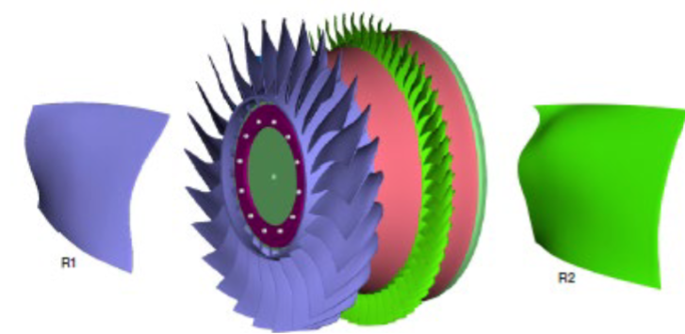
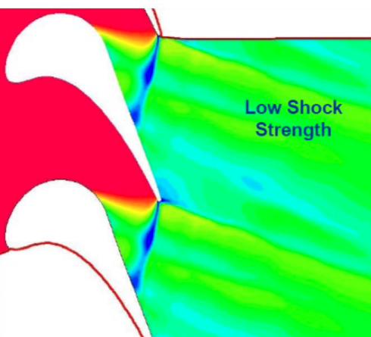
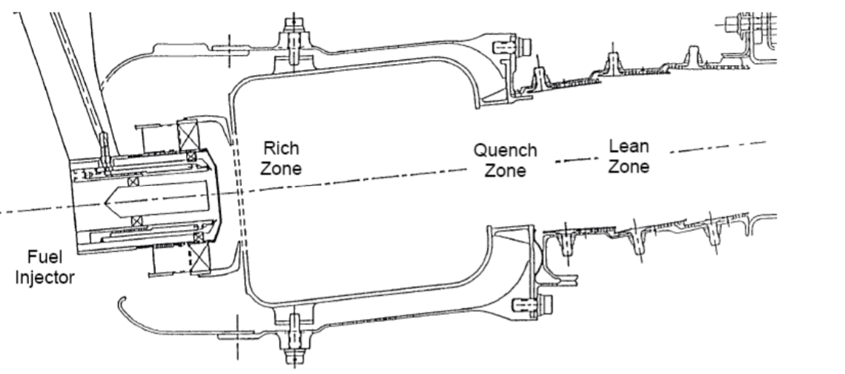
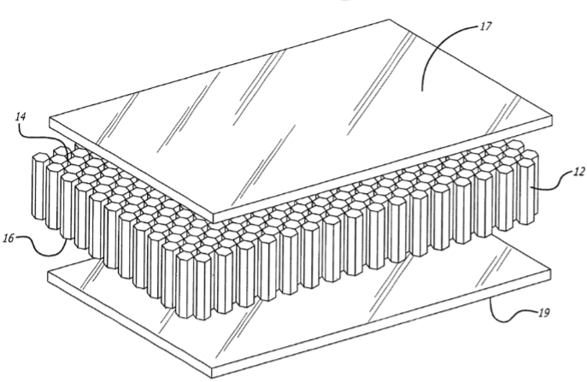
Technology Exploration
LTAG Technology | Technology Name | Effects on Performance | TRL
T32a | Highly Loaded Compressor | Through optimized non axisymmetric end wall design and advanced casing, increased loading capacity and minimize efficiency losses. | 7
T32b | Highly Loaded Turbine | Blade shape and end wall shape optimizing increases loading and reduces number of turbine stages. | 7
T65 | Rich Quench Lean (RQL) Zone Combustor | Ensuring Combustion stability (Rich Burn) and reducing nitrogen oxide emissions (Lean Burn) relative to published environmental standards. | 9
T80 | Advanced Sandwich Composites | Skin technology that incorporates a lattice composite sandwiched between two thin plates: yields a high structural integrity for little weight | 9
Problem Definition
Concept Space Exploration
Design Space Exploration
Technology Exploration
Concept Proposal

Slide 35
Technology Effects
Variable | Pre Technology Baseline | Newly Tech Infused Min | Newly Tech Infused Max
sAccess_Wt | 0.15156 | 0.15156 | 0.195035
ATD_Bleed | 0 | 0 | 0.005
Core_Nozz_s_Wt | 1 | 0.675 | 0
d_Burn_dP | 0.0235321 | 0.0235321 | 0.023662
FCDO | 1 | 0.97 | 1
FCDSUB | 0.885906 | 0.835906 | 0.885906
FRFU | 1 | 0.81 | 1.001
FRHT | 1 | 0.9 | 1
FRVT | 1 | 0.9 | 1
FRWI | 1 | 0.9 | 1.001
FRWI1 | 1 | 0.9 | 1
FRWI2 | 1 | 0.925 | 1
HPC_AFC_LossRatio | 1 | 1 | 2.76
HPC_AFC_nStages | 0 | 0 | 2
HPC_Deff | -0.01 | -0.01 | 0
HPC_Dutip | 357.83 | -337.18 | 357.83
HPC_FlowControl | 0 | 0 | 0.01
HPC_FSPRmax | 1.3 | 1.3 | 1.845
HPCPR | 10.954079 | 10.954079 | 29.2661
HPT_delta_desBladeTemp | 0 | 0 | 150
HPT_delta_desVaneTemp1 | 0 | 0 | 810
HPT_delta_desVaneTemp2 | 0 | 0 | 810
HPT_eff | 0.90184 | 0.90184 | 0.91084
HPT_Load | 0.6 | 0.6 | 0.768
HPT_Stator_rho | 0.312 | 0.2028 | 0.312
HPX | 250 | 250 | 250.05
LPT_Deff | 0.02791 | 0.02791 | 0.06891
LPT_delta_desBladeTemp | 0 | 0 | 150
LPT_delta_desVaneTemp | 0 | 0 | 810
LPT_Load | 2.4 | 2.4 | 3.072
LPT_Stator_rho | 0.313 | 0.2028 | 0.313
Each of these Variables Corresponds to Aircraft Performance
Problem Definition
Determined how infusing a new technology impacts the range (TIM)
Concept Space Exploration
Design Space Exploration
Technologies are going to impact these variables. Weights will get less, efficiency factors will go up, etc.
The Question is "by how much"
K-Factor Analysis simply puts a number, a "factor" to quantify that "by how much"
Technology Exploration
Concept Proposal
Aggregated the entire new range with all possible technology infusions

Slide 36
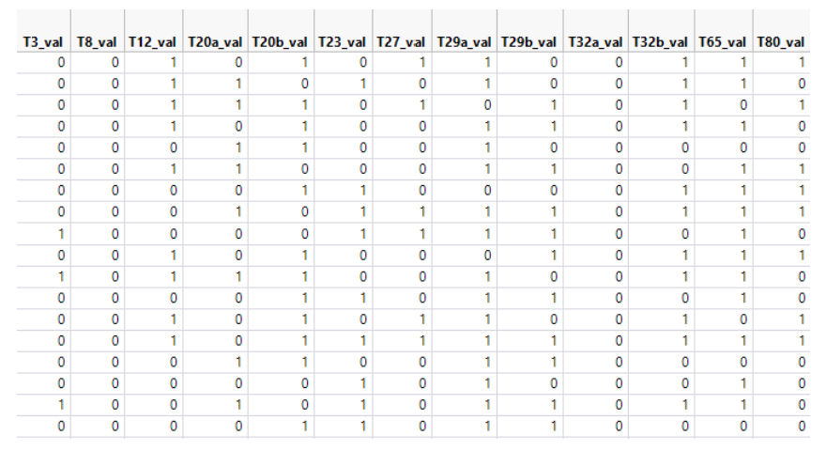
Technology Effects
Each of these Variables Corresponds to Aircraft Performance
Technology Compatibility Matrix
Problem Definition
Determined how infusing a new technology impacts the range (TIM)
Concept Space Exploration
Design Space Exploration
Aggregated the entire new range with all possible technology infusions
Technology Exploration
Concept Proposal
Developed our Technology Compatibility Matrix to show impacts of combinations of technology infusions

Slide 37
Technology Effects
Variable | Description
sAccess_Wt | Engine accessories weight fraction of bare engine weight
ATD_Bleed | Bleed Flow injected in the duct
Core_Nozz_s_Wt | Core nozzle weight scalar
d_Burn_dP | Burner Pressure Drop Intercept
FCDO | Lift Independent Drag Factor
FCDSUB | Factor to increase or decrease all subsonic drag coefficients
FRFU | Fuselage Weight Factor
FRHT | Horizontal Tail Weight
FRVT | Vertiacal Tail Weight
FRWI | Total Wing Weight Factor
FRWI1 | First term in wing weight equation
FRWI2 | Second term in wing weight equation
HPC_AFC_LossRatio | Ratio of baseline coefficient over loss coefficients with active flow control
HPC_AFC_nStages | Number of high-pressure compressor (HPC) stages to apply AFC Efficiency gain to
HPC_Deff | HPC Efficiency delta at aero design point (ADP)
HPC_Dutip | HPC tip speed delta at ADP
HPC_FlowControl | Bleed Flow required per stage
HPC_FSPRmax | Maximum HPC 1st stage pressure ratio
HPCPR | Pressure Ratio for High Pressure Compressor
HPT_delta_desBladeTemp | High Pressure Turbine (HPT) Blade temperature increase
HPT_delta_desVaneTemp1 | HPT Vane 1 temperature increase
HPT_delta_desVaneTemp2 | HPT Vane 2 temperature increase
HPT_eff | HPT Adiabatic efficiency at ADP
HPT_Load | High Pressure Turbine Loading
HPT_Stator_rho | High Pressure Turbine stator material density
HPX | Engine Horse Power Extraction (Constant)
LPT_Deff | Low Pressure turbine efficiency adder
LPT_delta_desBladeTemp | Low pressure turbine blade temperature increase
LPT_delta_desVaneTemp | LPT Bvane temperature increase
LPT_Load | Low pressure turbine loading
LPT_Stator_rho | Low presure turbine stator material density
Each of these Variables Corresponds to Aircraft Performance
Problem Definition
Determined how infusing a new technology impacts the range (TIM)
Concept Space Exploration
Design Space Exploration
Aggregated the entire new range with all possible technology infusions
Technology Exploration
Concept Proposal
Developed our Technology Compatibility Matrix to show impacts of combinations of technology infusions
Used our new ranges coupled with our TCM to develop new DOE

Slide 38
Technology Effects
Variable | Description
sAccess_Wt | Engine accessories weight fraction of bare engine weight
ATD_Bleed | Bleed Flow injected in the duct
Core_Nozz_s_Wt | Core nozzle weight scalar
d_Burn_dP | Burner Pressure Drop Intercept
FCDO | Lift Independent Drag Factor
FCDSUB | Factor to increase or decrease all subsonic drag coefficients
FRFU | Fuselage Weight Factor
FRHT | Horizontal Tail Weight
FRVT | Vertiacal Tail Weight
FRWI | Total Wing Weight Factor
FRWI1 | First term in wing weight equation
FRWI2 | Second term in wing weight equation
HPC_AFC_LossRatio | Ratio of baseline coefficient over loss coefficients with active flow control
HPC_AFC_nStages | Number of high-pressure compressor (HPC) stages to apply AFC Efficiency gain to
HPC_Deff | HPC Efficiency delta at aero design point (ADP)
HPC_Dutip | HPC tip speed delta at ADP
HPC_FlowControl | Bleed Flow required per stage
HPC_FSPRmax | Maximum HPC 1st stage pressure ratio
HPCPR | Pressure Ratio for High Pressure Compressor
HPT_delta_desBladeTemp | High Pressure Turbine (HPT) Blade temperature increase
HPT_delta_desVaneTemp1 | HPT Vane 1 temperature increase
HPT_delta_desVaneTemp2 | HPT Vane 2 temperature increase
HPT_eff | HPT Adiabatic efficiency at ADP
HPT_Load | High Pressure Turbine Loading
HPT_Stator_rho | High Pressure Turbine stator material density
HPX | Engine Horse Power Extraction (Constant)
LPT_Deff | Low Pressure turbine efficiency adder
LPT_delta_desBladeTemp | Low pressure turbine blade temperature increase
LPT_delta_desVaneTemp | LPT Bvane temperature increase
LPT_Load | Low pressure turbine loading
LPT_Stator_rho | Low presure turbine stator material density
Used our new ranges coupled with our TCM to develop new DOE
Problem Definition
A second design of experiments was created with the technology infused baseline​
The input variables are 31 variables that can be impacted by the infused technologies​
​
The Latin Hypercube DoE was created out of 5000 cases
1000 Edge Cases​
3999 Interior Cases​
1 Baseline Case
Concept Space Exploration
Design Space Exploration
Technology Exploration
Concept Proposal

Slide 39
Technology Selection Analytical Approach
Problem Definition
Which collection of technologies can even work?
Which technologies matter the most?
Select and Implement the right technologies
Concept Space Exploration
Design Space Exploration
Technology Exploration
Filtered Constellation Plot Analysis
Technology Sensitivity Study
TOPSIS
Concept Proposal

Slide 40
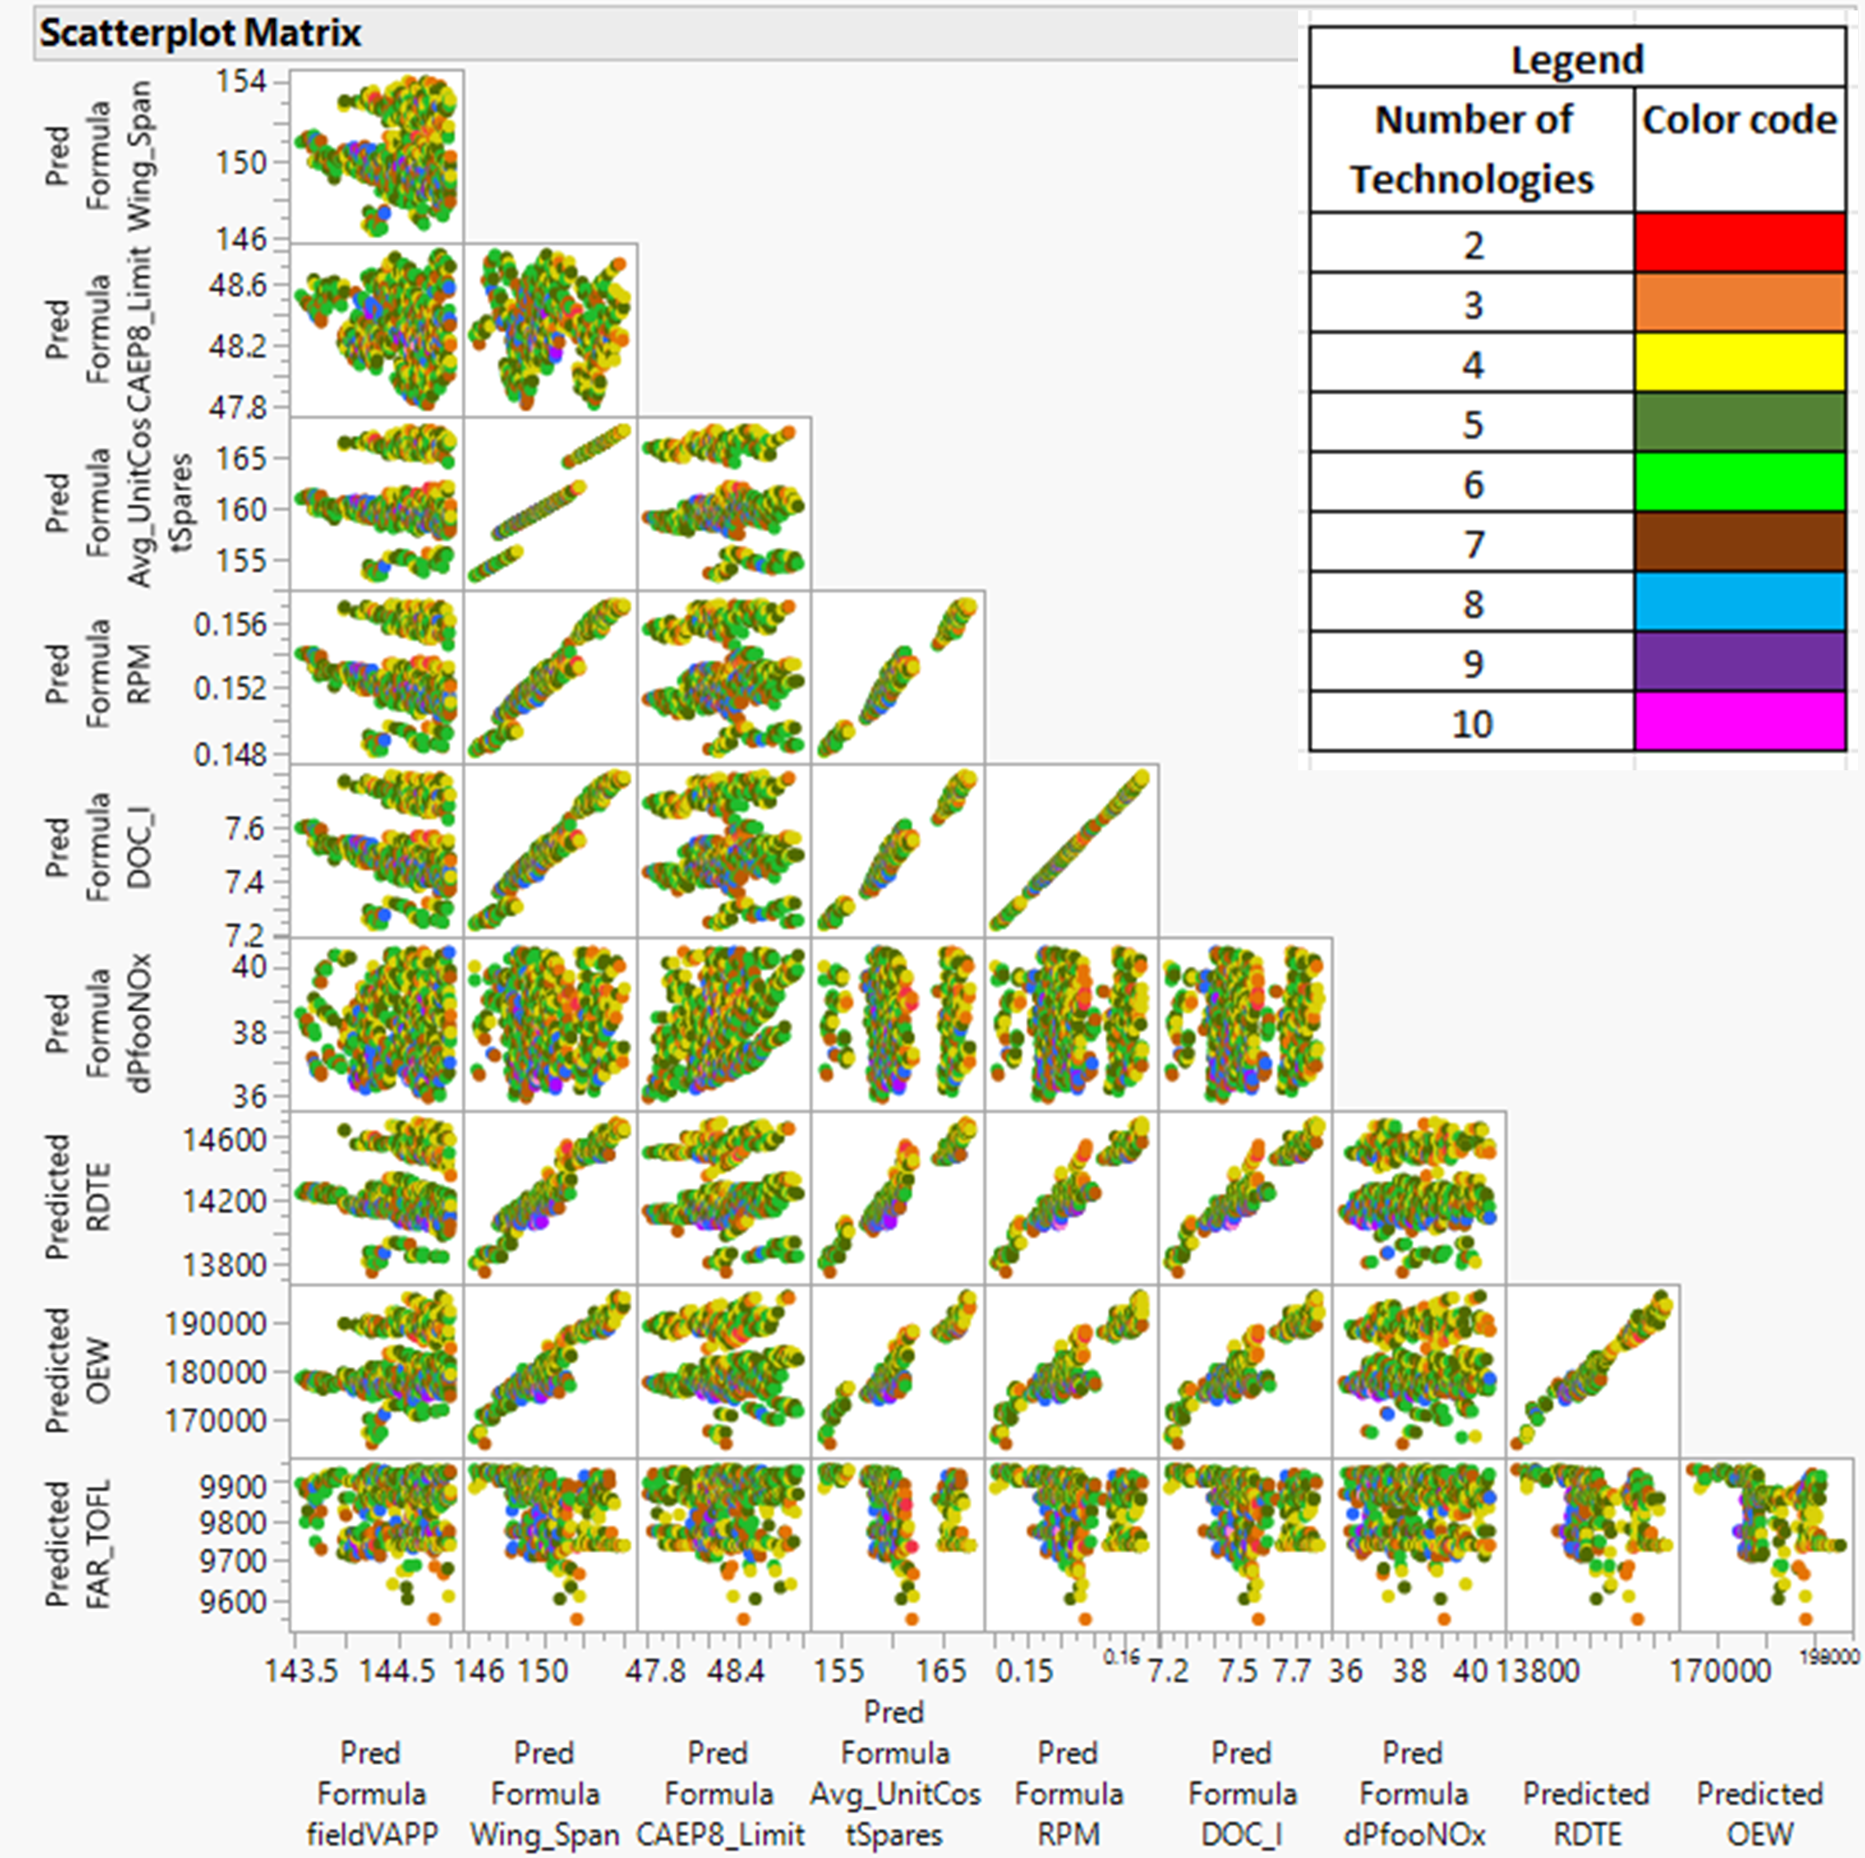
Filtered Constellation Plots
Filtered Constellation Plot Analysis
Which collection of technologies can even work?
Problem Definition
Concept Space Exploration
Constellation Plots shows all possible alternatives that satisfy our relaxed constraints
Strong Correlation regardless of number of technologies shows that they'd be correlated regardless of infusion
"Clumping " Shows a specific technology or a specific combination technology family dominates the response
Design Space Exploration
Technology Exploration
Concept Proposal
Our optimal solution with technology infusions will most likely contain 4-6 technologies

Slide 41
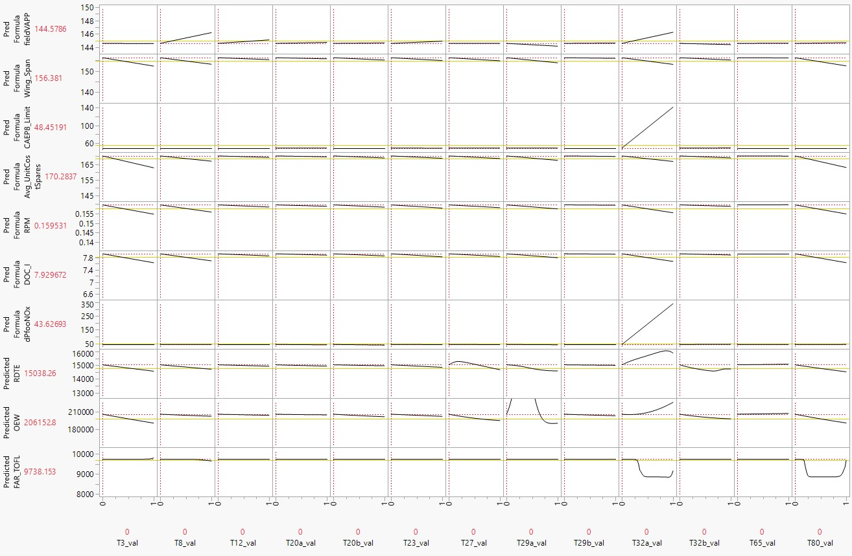
Technology Sensitivity Study
Technology Sensitivity Study
Which technologies matter the most?
Problem Definition
Concept Space Exploration
Design Space Exploration
Technology Exploration
Concept Proposal

Slide 42
Technology Selection
System Metrics | Requirement | Baseline | Best Value obtained by infusing technology | Requirement Satisfied?
fieldVAPP [KNOTS] | 123.25 | 145 | 143.57 | No
FAR_TOFL [ft] | 8236.874 | 9690.44 | 9550.34 | No
OEW [lb] | 148830 | 198440 | 164870 | No
Wing_Span [ft] | 154.77 | 154.77 | 146.36 | Yes
dPfooNOx [g/kN] | 40.2704 | 50.34 | 35.91 | Yes
CAEP8_Limit | 55.7654 | 55.77 | 47.81 | Yes
RDTE [M$] | Minimize | 14763.6 | 13749.8 | Yes
Avg_UnitCostSpares [M$] | 143.26325 | 168.55 | 153.36 | No
DOC_I [¢/ASM] | 6.264 | 7.83 | 7.238 | No
RPM [$] | Minimize | 0.15773 | 0.14803 | Yes
TOPSIS
Select and Implement the right technologies
Problem Definition
Concept Space Exploration
Design Space Exploration
Technology Exploration
Concept Proposal

Slide 43
Technology Selection
System Metrics | Requirement | Baseline | Best Value obtained by infusing technology | Requirement Satisfied?
fieldVAPP [ft/s] | 123.25 | 145 | 143.57 | No
FAR_TOFL [ft] | 8236.874 | 9690.44 | 9550.34 | No
OEW [lb] | 148830 | 198440 | 164870 | No
Wing_Span [ft] | 154.77 | 154.77 | 146.36 | Yes
dPfooNOx [g/kN] | 40.2704 | 50.34 | 35.91 | Yes
CAEP8_Limit | 55.7654 | 55.77 | 47.81 | Yes
RDTE [M$] | Minimize | 14763.6 | 13749.8 | Yes
Avg_UnitCostSpares [M$] | 143.26325 | 168.55 | 153.36 | No
DOC_I [¢/ASM] | 6.264 | 7.83 | 7.238 | No
RPM [$] | Minimize | 0.15773 | 0.14803 | Yes
TOPSIS
Select and Implement the right technologies
Technology Infusion alone is insufficient to meet these standards
Problem Definition
Concept Space Exploration
Design Space Exploration
Technology Exploration
Must also relax some constraints to generate a feasible design space
Concept Proposal

Slide 44

Technology Selection
TOPSIS
Select and Implement the right technologies
System Metrics | Requirement | Baseline | Best Value obtained by infusing technology | Requirement Satisfied? | Old Target | New Target
fieldVAPP [KNOTS] | 123.25 | 145 | 143.57 | No | -15 % | -.8466 %
FAR_TOFL [ft] | 8236.874 | 9690.44 | 9550.34 | No | -15 % | -1.2469 %
OEW [lb] | 148830 | 198440 | 164870 | No | -25 % | -15.27 %
Wing_Span [ft] | 154.77 | 154.77 | 146.36 | Yes
DPfooNOx [g/kN] | 40.2704 | 50.34 | 35.91 | Yes
CAEP8_Limit | 55.7654 | 55.77 | 47.81 | Yes
RDTE [M$] | Minimize | 14763.6 | 13749.8 | Yes
Avg_UnitCostSpares [M$] | 143.26325 | 168.55 | 153.36 | No | -15 % | -8.416 %
DOC_I [¢/ASM] | 6.264 | 7.83 | 7.238 | No | -20 % | -6.543 %
RPM [$] | Minimize | 0.15773 | 0.14803 | Yes
Problem Definition
Concept Space Exploration
Design Space Exploration
Technology Exploration
Concept Proposal

Slide 45
Technology Selection
Rank | Field VAPP [ft/s] | Wing_ Span [ft] | CAEP8_ Limit | AVG_Unit Cost Spares [M$] | RPM [M$] | DOC_I [¢/ASM] | DPfooNOx [g/kN] | RDTE [M$] | OEW [Ib] | FAR_TOFL [ft] | Number
1 | 144.9 | 153.69 | 48.71 | 167.3 | 0.15 | 7.77 | 40.21 | 14650.0 | 195494 | 9738.16 | 843
2 | 144.9 | 153.85 | 48.72 | 167.46 | 0.15 | 7.78 | 40.07 | 14643.9 | 195067 | 9738.16 | 7011
3 | 144.96 | 153.48 | 8.67 | 167.05 | 0.15 | 7.76 | 39.91 | 14641.9 | 194751 | 9738.18 | 4583
4 | 144.67 | 153.08 | 48.21 | 166.55 | 0.15 | 7.73 | 40.2 | 14511.5 | 191259 | 9856.03 | 2458
5 | 144.68 | 153.03 | 48.25 | 166.5 | 0.15 | 7.73 | 40.27 | 14509.9 | 190954 | 9854.58 | 6611
Problem Definition
Concept Space Exploration
Design Space Exploration
Technology Exploration
Our metrics of interest are weighted per requirements / stakeholder feedback
Concept Proposal
The alternative with the lowest Euclidian geometric distance to weighted response is the optimal

Slide 46
Explore Chosen Technology Family
Rank | Field VAPP[ft/s] | Wing_ Span[ft] | CAEP8_ Limit | AVG_Unit Cost Spares [M$] | RPM [M$] | DOC_I [¢/ASM] | DPfooNOx [g/kN] | RDTE [M$] | OEW [Ib] | FAR_TOFL [ft] | Number
1 | 144.9 | 153.69 | 48.71 | 167.3 | 0.15 | 7.77 | 40.21 | 14650.0 | 195494 | 9738.16 | 843
Problem Definition
Our metrics of interest are weighted per requirements / stakeholder feedback
Concept Space Exploration
Design Space Exploration
The alternative with the lowest Euclidian geometric distance to weighted response is the optimal
Technology Exploration
Concept Proposal
Assess the combination of technology family that yields best TOPSIS result

Slide 47
Explore Chosen Technology Family
Rank | Field VAPP[ft/s] | Wing_ Span[ft] | CAEP8_ Limit | AVG_Unit Cost Spares [M$] | RPM [M$] | DOC_I [¢/ASM] | DPfooNOx [g/kN] | RDTE [M$] | OEW [Ib] | FAR_TOFL [ft] | Number
1 | 144.9 | 153.69 | 48.71 | 167.3 | 0.15 | 7.77 | 40.21 | 14650.0 | 195494 | 9738.16 | 843
Problem Definition
Our metrics of interest are weighted per requirements / stakeholder feedback
Concept Space Exploration
T12: Riblets
Design Space Exploration
The alternative with the lowest Euclidian geometric distance to weighted response is the optimal
T32b: Highly Loaded Turbine
Technology Exploration
T20b: Active Compressor Flow Control
Concept Proposal
Assess the combination of technology family that yields best TOPSIS result
T65: RQL Zone Combustor
T29b: Ceramic Matrix Composite Vanes

Slide 48

Technology Infusion Comparison
Problem Definition
Concept Space Exploration
Design Space Exploration
Technology Exploration
Concept Proposal

Slide 49
Technology Infusion Comparison
Problem Definition
Concept Space Exploration
Design Space Exploration
Technology Exploration
Technology is most sensitive and has greatest impact on performance
Concept Proposal
Most critical to infuse for meeting the requirements

Slide 50
Technology Infusion Comparison
Problem Definition
Concept Space Exploration
Design Space Exploration
Technology Exploration
Technology is most sensitive and has greatest impact on performance
Uncertainty surrounding the impact due to TRL
Concept Proposal
Most economically valuable to infuse near and long term
Most critical to infuse for meeting the requirements

Slide 51
Technology Exploration
LTAG Technology | TRL | Research + Development Degree of Difficulty (RD³) (Lower is Better) | Sensitivity Rank
T12 - Riblets | 8 | Active development and wind testing completed for multiple 3D Designs. Large scale production still a problem to solve. [5] LOW - MEDIUM RD³ | 3
T20b - Active Compressor Flow Control | 6 | Lots of established research on tip clearance, but less established research and manufacturing on low energy flow removal. [6] HIGHEST RD³ | 2
T29b – Ceramic Matrix Composite Vanes | 7 | Thorough in-depth thermal complete. Verified simple manufacturing processes through weaving. Large scale production still needs to be developed. [7] LOW RD³ | 4
T32b – Highly Loaded Turbine | 7 | Computational and wind tunnel tested. Low efficacy in manufacturing and production. Continued testing at AFRL Turbine Testing Facility. [8] MEDIUM - HIGH RD³ | 1 (Most)
T65 – RQL Zone Combustor | 9 | RQL Combustor designed and tested by GE, with an established manufacturing process and production system. LOWEST RD³ | 5 (Least)
Problem Definition
Concept Space Exploration
Design Space Exploration
Technology Exploration
Concept Proposal

Slide 52
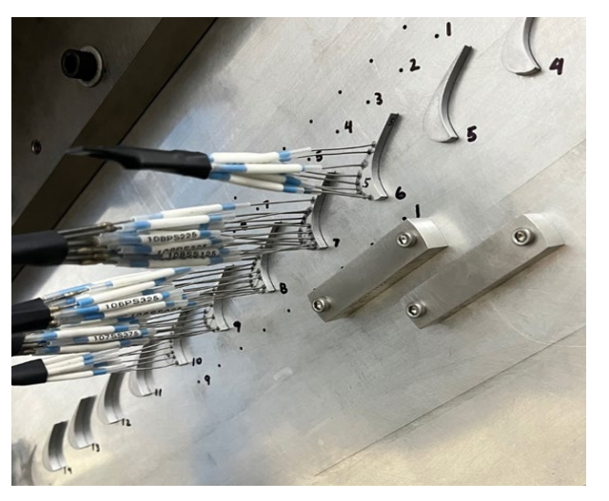
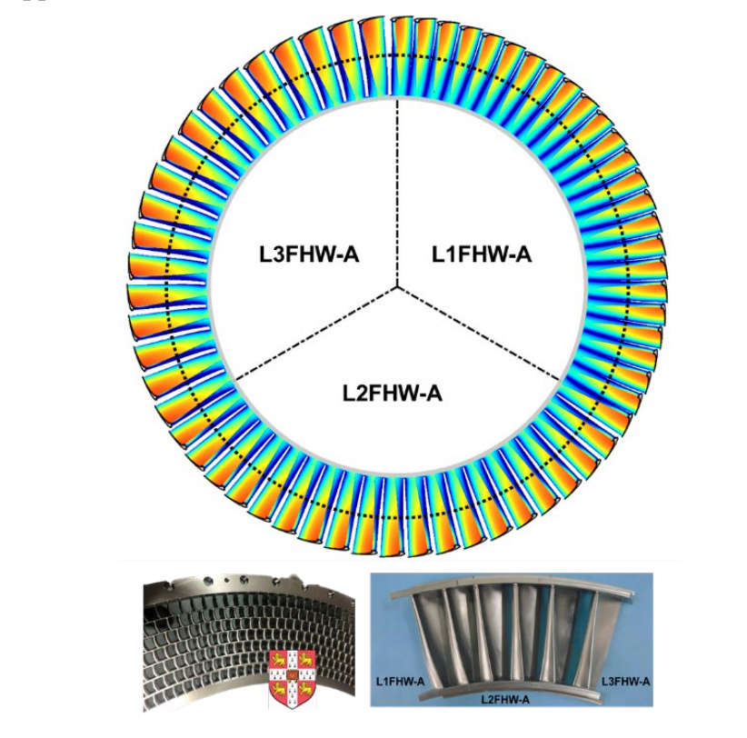
Phase 1 Technology Implementation
Highly Loaded Turbine
Projected Impacts
Blade Shape Optimization
End wall Shape Optimization
Flow Control through Cascades
___________________________
All mechanisms to increase turbine loading and decrease number of needed stages
Increased Bleed flow to Turbine
Increased loading on the high pressure turbine and low pressure turbine
Efficiency loss minimized and remains constant throughout
Problem Definition
Concept Space Exploration
Design Space Exploration
Technology Exploration
References
[8] Clark, JP, Paniagua, G, & Cukurel, B. "On the Development of High Lift, High Work Low-Pressure Turbines." Proceedings of the ASME Turbo Expo 2023: Turbomachinery Technical Conference and Exposition. Volume 13B: Turbomachinery — Axial Flow Turbine Aerodynamics. Boston, Massachusetts, USA. June 26–30, 2023. V13BT30A029. ASME Available: Online. [9] Germain, T., Nagel, M., Raab, I., Schüpbach, P., Abhari, R. S., and Rose, M. (January 12, 2010). "Improving Efficiency of a High Work Turbine Using Nonaxisymmetric Endwalls— Part I: Endwall Design and Performance." ASME. J. Turbomach. April 2010; 132(2): 021007. Available: Online
Concept Proposal
Rainbow cascade and associated inlet flow conditioning
Linear Cascade at AFRL Turbine Facility

Slide 53
Technology Implementation Phasing Construct
Phase 1
Gold Phase
Infuse T32b
Immediately
Y
Phase 2
Silver Phase
Infuse T12
Infuse T65
Y + 2 Years
Phase 3
Black Phase
Infuse T20b
Infuse T29b
Y + 4 Years
Problem Definition
Concept Space Exploration
Design Space Exploration
Technology Exploration
Concept Proposal

Slide 54
Comparison of Designs
System Metrics | Baseline | Optimized Baseline | Optimized Technology Infused at Phase 3
fieldVAPP [ft/s] | 145 | 136.6 | 135.5
FAR_TOFL [ft] | 9690.44 | 9442.25 | 9429.24
OEW [lb] | 198440 | 202356 | 194688.8
Wing_Span [ft] | 154.77 | 153.93 | 153.23
DPfooNOx [g/kN] | 50.34 | 42.12 | 41.76
CAEP8_Limit | 55.77 | 49.79 | 50.97
RDTE [M$] | 168.55 | 168.48 | 111.475
Avg_UnitCostSpares [M$] | 14763.6 | 14635.8 | 14073.73
DOC_I [cents/ASM] | 7.83 | 7.874 | 5.778
RPM [$] | 0.15773 | 0.15878 | 0.1252
Problem Definition
Concept Space Exploration
Design Space Exploration
Technology Exploration
Concept Proposal
Notes:
Here we have presented the comparison between the technology infused optimized design. Of particular importance is the % reduction of the system metrics between baseline and the technology infused design. The approach velocity is reduced about 6.6%, so that results in a lower power and fuel consumption. With all the technologies in place, we have managed to reduce the emissions by about 17% and make it environmentally more friendly. We can also notice that the DOC_I has been reduced by a significant 26.2%, so the airlines can now charge lower RPM for the same profit, or they can charge the same RPM and make more profit.

Slide 55
Comparison of Designs
System Metrics | Baseline | Optimized Technology Infused at Phase 3 | % Reduction
fieldVAPP [ft/s] | 145 | 135.5 | 6.6
FAR_TOFL [ft] | 9690.44 | 9429.24 | 2.7
OEW [lb] | 198440 | 194688.8 | 1.9
Wing_Span [ft] | 154.77 | 153.23 | 1.0
DPfooNOx [g/kN] | 50.34 | 41.76 | 17.0
CAEP8_Limit | 55.77 | 50.97 | 8.6
RDTE [M$] | 168.55 | 111.475 | 33.9
Avg_UnitCostSpares [M$] | 14763.6 | 14073.73 | 4.7
DOC_I [cents/ASM] | 7.83 | 5.778 | 26.2
RPM [$] | 0.15773 | 0.1252 | 20.6
Problem Definition
Lesser Fuel
Concept Space Exploration
Design Space Exploration
Eco-Friendly
Technology Exploration
Concept Proposal
Save $
More Profit $
Notes:
Here we have presented the comparison between the technology infused optimized design. Of particular importance is the % reduction of the system metrics between baseline and the technology infused design. The approach velocity is reduced about 6.6%, so that results in a lower power and fuel consumption. With all the technologies in place, we have managed to reduce the emissions by about 17% and make it environmentally more friendly. We can also notice that the DOC_I has been reduced by a significant 26.2%, so the airlines can now charge lower RPM for the same profit, or they can charge the same RPM and make more profit.

Slide 56
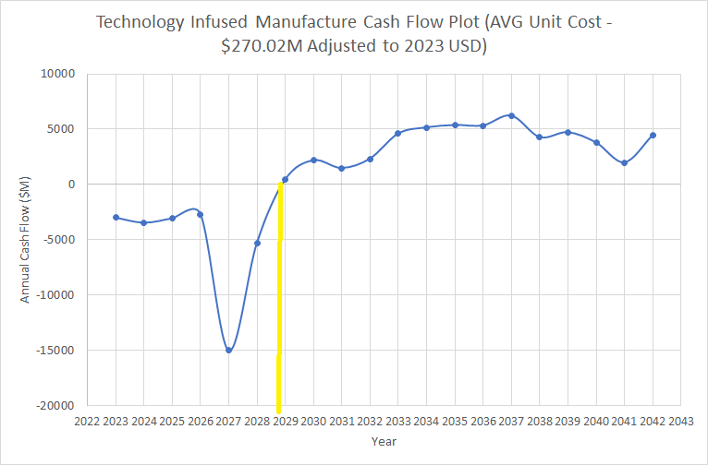
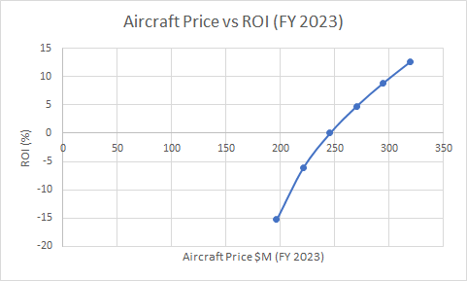
Manufacturer Economics Technology Infused
Problem Definition
Concept Space Exploration
Design Space Exploration
Technology Exploration
Concept Proposal
Manufacturer will breakeven in 5.9 years with a 0 % ROI
ROI with a technology infused baseline cost $270 M is 4.80 ROI %
Notes:
All calculations for Cashflow and ROI (%) are in 2005 USD for a 20-year production schedule and have been adjusted to a 2023 timeline and 2023 USD

Slide 57
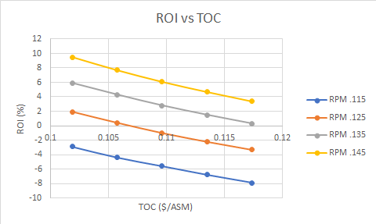
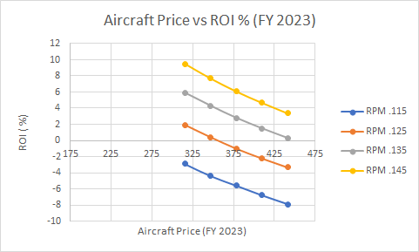
Final Airline Economics
Problem Definition
Concept Space Exploration
Design Space Exploration
Technology Exploration
Airline performs 693 Trips per year with a trip distance of 3200 nmi
At the technology infused baseline value of .146 Average Yield/RPM the airline return on investment is 10% and the final aircraft price is $315 M USD (FY 2023)
By reducing the acquisition price, the RPM will decrease for the same ROI thus increasing the airline’s profit
Concept Proposal

Slide 58

Comparison of Manufacturers Cash Flow
16.3 Billion $
Problem Definition
Concept Space Exploration
Design Space Exploration
Technology Exploration
Concept Proposal
At the end of a 20-year period the technology infused aircraft outperforms the baseline aircraft by roughly 16.3 billion dollars for approximately the same aircraft price
Assumption: Cost of Technology is not included, however that does not affect the final trend
Notes:
This plot compares the manufacturers net cash flow for varying aircraft prices
Here we have presented the cashflow comparison between the aircrafts with all the technology (shown by solid circles) infused and the one without any technology (shown by open circles).
Aircrafts with out technologies have open circles

Slide 59

Baseline-Final Airline Economic Comparisons
The inclusion of technologies creates a significant difference in the ROI increasing the ROI for the same RPM by approximately .6 %
Also reduces Aircraft Price
When comparing the 10% ROI values for the baseline and the technology infused aircraft, the baselines Average Yield/RPM is .158 while the technology infused aircraft’s Average Yield/ RPM is .146
The price of the baseline aircraft is $341.75 M USD (FY 2023)
The final aircraft price of the technology infused aircraft is $315.05 M USD (FY 2023), this price is 26.698 Million dollars less than the baseline aircraft for the same RPM
Therefore, the infusion of technologies allows the aircraft manufacturer to charge more, thus increasing revenue
Problem Definition
Concept Space Exploration
Design Space Exploration
Technology Exploration
Concept Proposal

Slide 60


Economic Robustness
Uncertainty in technology between -25% to 10% affects the Cashflow by only 0.085%
ROI at 0.135 $/RPM increases by adding more technology
Problem Definition
Concept Space Exploration
Design Space Exploration
Technology Exploration
Concept Proposal

Slide 61


Closing the Design Loop Final Proposal overlayed to Baseline

Slide 62
Conclusion
Characteristic​ | Baseline | Technology Infused
Thrust to Weight Ratio​ | 0.2652 | 0.2802
Wing Loading​ [lbf-ft²] | 118.65 | 115
Span​ [ft] | 156.1 ft​ | 153.23 ft
A technologically advanced aircraft designed to be environmentally friendly, less expensive, and more profitable to all stakeholders
Releases less emissions
Yields more profit for the same ROI

Slide 63
THANK YOU

Slide 64
APPENDIX

Slide 65
References
[1] International Civil Aviation Organization, "Future of Aviation", 2023.
[2] Cargo Flash. "Types of Aircraft Used in Air Cargo Business: 2023 Edition" 2023. Available: Online
[3] Chandrakanth, R. "Engines that Power Narrowbody Planes". SPS Aviation. 07 JUL 2017. Available: Online
[4] Mavris, Dimitri. "Technology Identification, Evaluation, and Selection (TIES) Method," Georgia Institute of Technology, Lecture, 2023.
[5] Paul D. McClure, Brian R. Smith and Wink Baker. "Design and Testing of 3-D Riblets," AIAA 2020-0311. AIAA Scitech 2020 Forum. January 2020. Available: Online.
[6] Yu B, Ke H, Shen E, Zhang T. "A review of blade tip clearance–measuring technologies for gas turbine engines." Measurement and Control. 2020. 53(3-4):339-357. Available: Online.
[7] Watanabe, F, Nakamura, T, & Mizokami, Y. "Design and Testing for Ceramic Matrix Composite Turbine Vane." Proceedings of the ASME Turbo Expo 2017: Turbomachinery Technical Conference and Exposition. Volume 6: Ceramics; Controls, Diagnostics and Instrumentation; Education; Manufacturing Materials and Metallurgy. Charlotte, North Carolina, USA. June 26–30, 2017. V006T02A003. ASME Available: Online
[8] Clark, JP, Paniagua, G, & Cukurel, B. "On the Development of High Lift, High Work Low-Pressure Turbines." Proceedings of the ASME Turbo Expo 2023: Turbomachinery Technical Conference and Exposition. Volume 13B: Turbomachinery — Axial Flow Turbine Aerodynamics. Boston, Massachusetts, USA. June 26–30, 2023. V13BT30A029. ASME Available: Online
[9] Germain, T., Nagel, M., Raab, I., Schüpbach, P., Abhari, R. S., and Rose, M. (January 12, 2010). "Improving Efficiency of a High Work Turbine Using Nonaxisymmetric Endwalls— Part I: Endwall Design and Performance." ASME. J. Turbomach. April 2010; 132(2): 021007. Available: Online

Slide 66
Methodology for Solving the Problem
Problem Definition
Modeling and Simulation
Evaluate Technologies
Feasibility
Viability
Concept Space Definition
Explore Design Space
Identify Technologies
Select Technologies

Slide 67
Design of Experiments (DoE)
Variable | description
sAccess_Wt | Engine accessories weight fraction of bare engine weight
Core_Nozz_s_Wt | Core nozzle weight scalar
d_Burn_dP | Burner pressure drop intercept
FCDO | Lift independent drag factor
FCDSUB | Factor to increase or decrease all subsonic drag coefficients
FRWI | Total wing weight factor
HPC_AFC_LossRatio | ratio of baseline loss coefficient over loss coefficient with endwall and boundary layer active flow control
HPX | engine horse power extraction (constant)
A second design of experiments was created with the technology infused baseline
The input variables are 31 variables that can be impacted by the infused technologies
The DoE was still created out of 5000 cases
1000 Edge Cases
3999 Interior Cases
1 Baseline Case
Some examples of input variables in this DOE

Slide 70
Design Variable Ranges
Main text – Navy Roboto 24px.
Example of a sub point. 18px Roboto
Subpoint example
Sub-sub point example the first
And the second

Slide 71
Performance Design Space
Main text – Navy Roboto 24px.
Example of a sub point. 18px Roboto
Subpoint example
Sub-sub point example the first
And the second

Slide 72
Economics Design Space
Main text – Navy Roboto 24px.
Example of a sub point. 18px Roboto
Subpoint example
Sub-sub point example the first
And the second

Slide 73
Optimized Baseline
Main text – Navy Roboto 24px.
Example of a sub point. 18px Roboto
Subpoint example
Sub-sub point example the first
And the second

Slide 74




Step-9 CDF
Feasible Space
Feasible Space
NO Feasible Space
Feasible Space

Slide 75






NO Feasible Space
Limited Feasible Space
Limited Feasible Space
Feasible Space
Limited Feasible Space
Feasible Space

Slide 76

Step-9 Monte Carlo Filtered Results

Slide 77

Checking for Goodness
Problem Definition
Sufficiently good
R square: larger than 95%
Model Fit Error（MFE）
Model Representation Error（MRE）
Concept Space Exploration
Design Space Exploration
Technology Exploration
Concept Proposal

Slide 78
Insert T-32 b to Optimized Baseline
Change K factors – affects certain values

